Slide 1
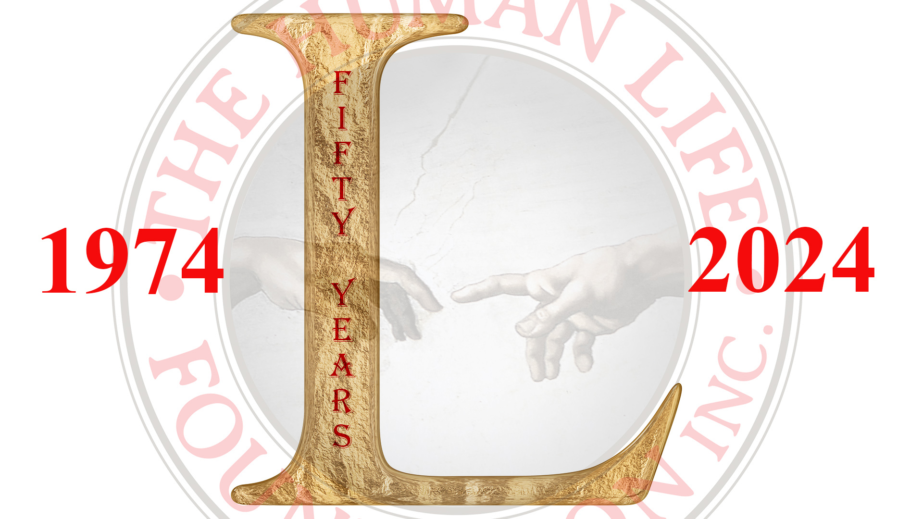

Slide 2
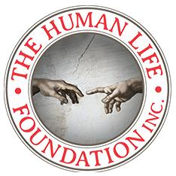
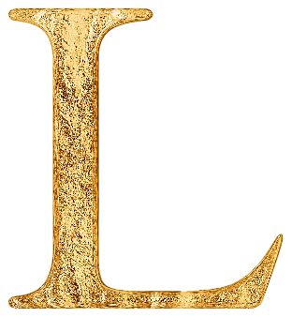
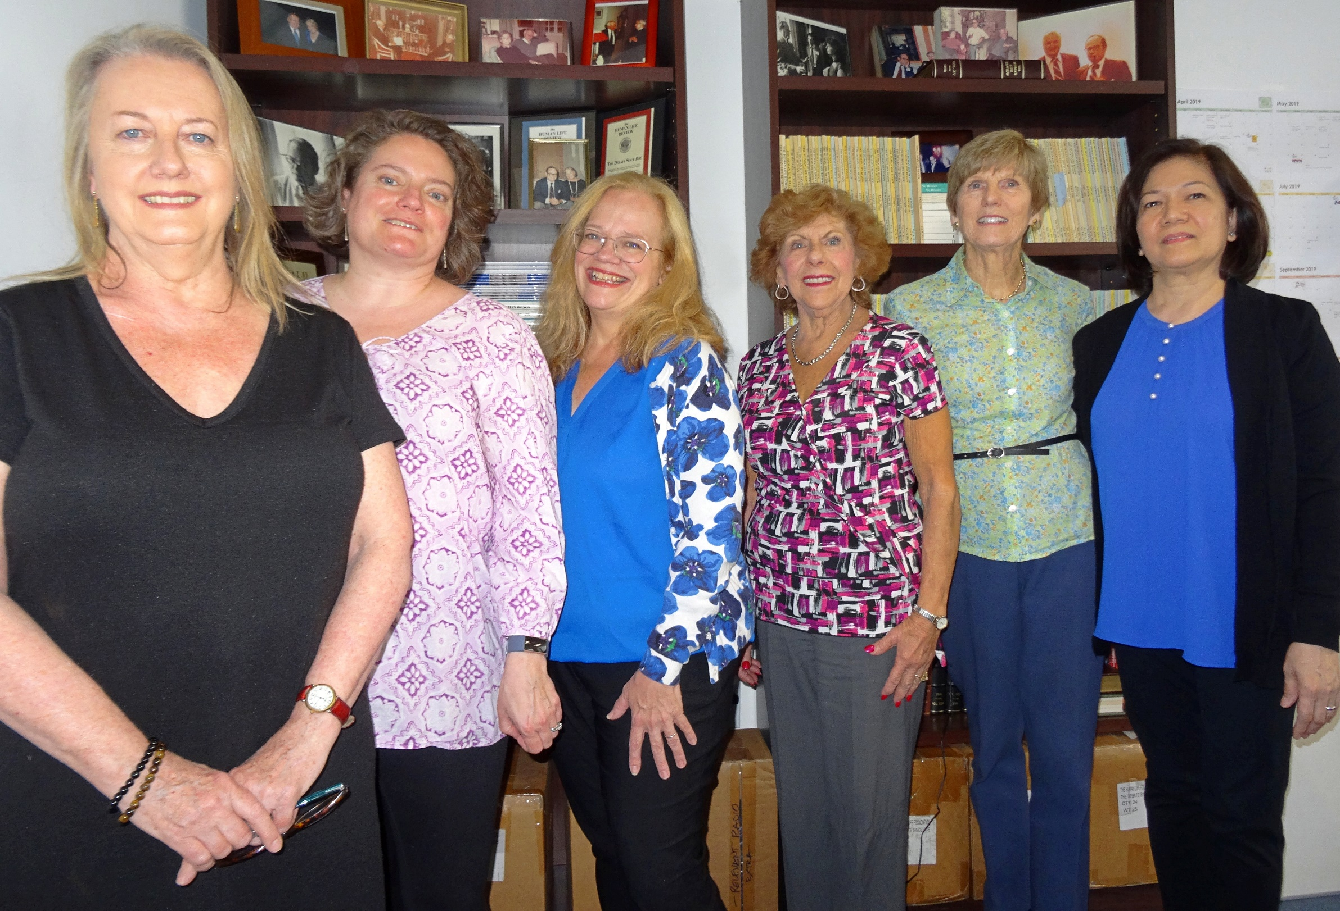
1974
2024
Anne, Christina, Maria, Rose, Pat, and Ida

Slide 3
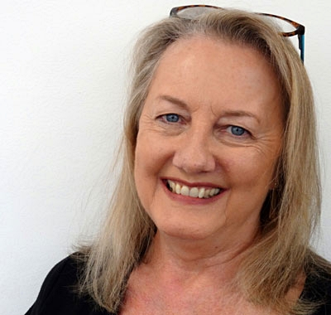
1974
2024
Anne Conlon, Editor of the Human Life Review

Slide 5
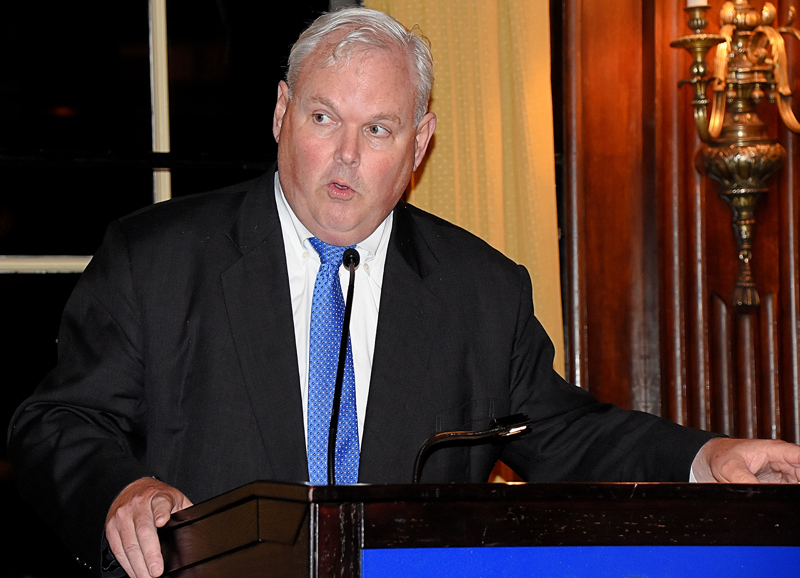
1974
2024
William McGurn , Great Defender of Life 2010

Slide 6
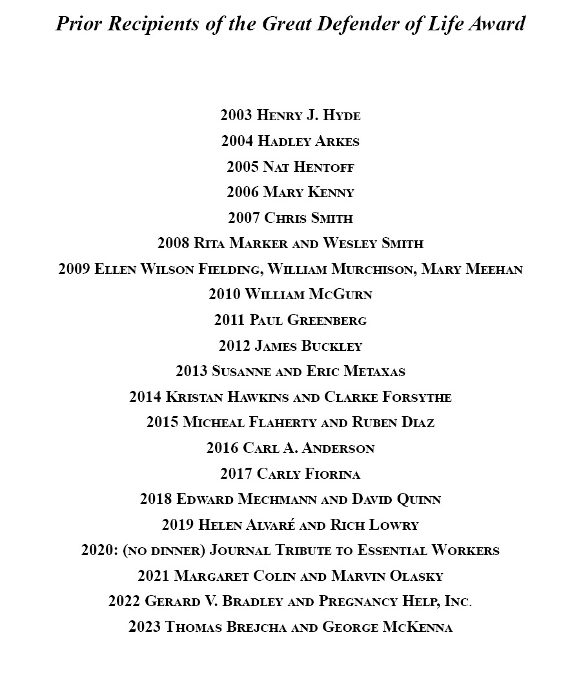

Slide 7
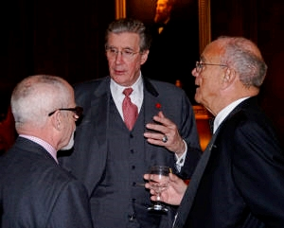
1974
2024
Brad Miner, George Marlin, and Michael Long

Slide 8
“The Human Life Review has been the most important journal in the pro-life movement from Day One. Now it is Year Fifty, and the Review is still the standard-bearer, the go-to resource for all of us in the fight for unborn life. Dobbs is a game-changer. But the challenges ahead -- though different -- are no less daunting. Our tiniest brothers and sisters need the Review’s insights, courage, and witness to the truth more than ever. My sincerest congratulations, and thanks, to Maria McFadden and her collaborators for keeping this beacon so well-lit.”
—Gerard Bradley, Great Defender of Life 2022

Slide 9
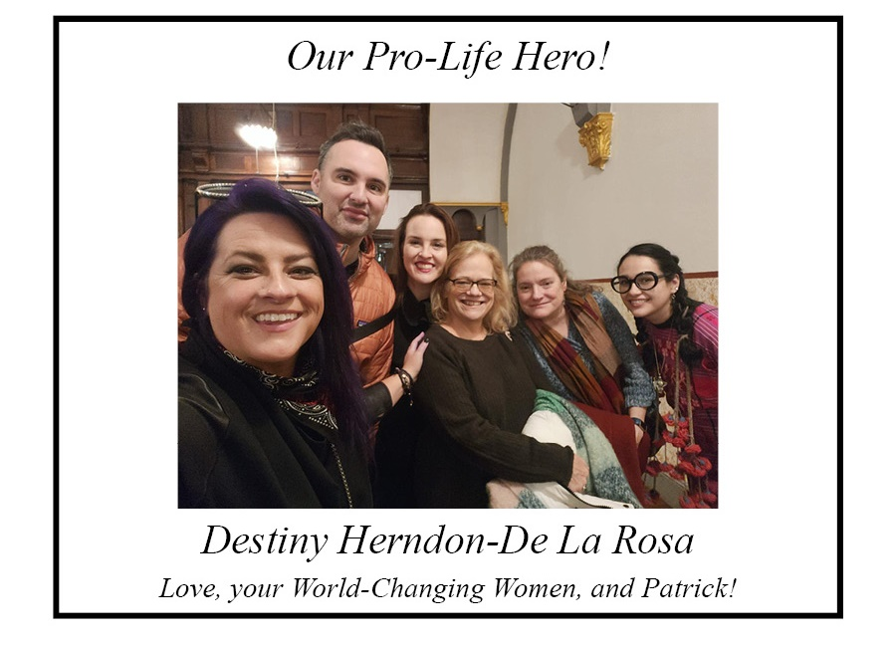

Slide 10
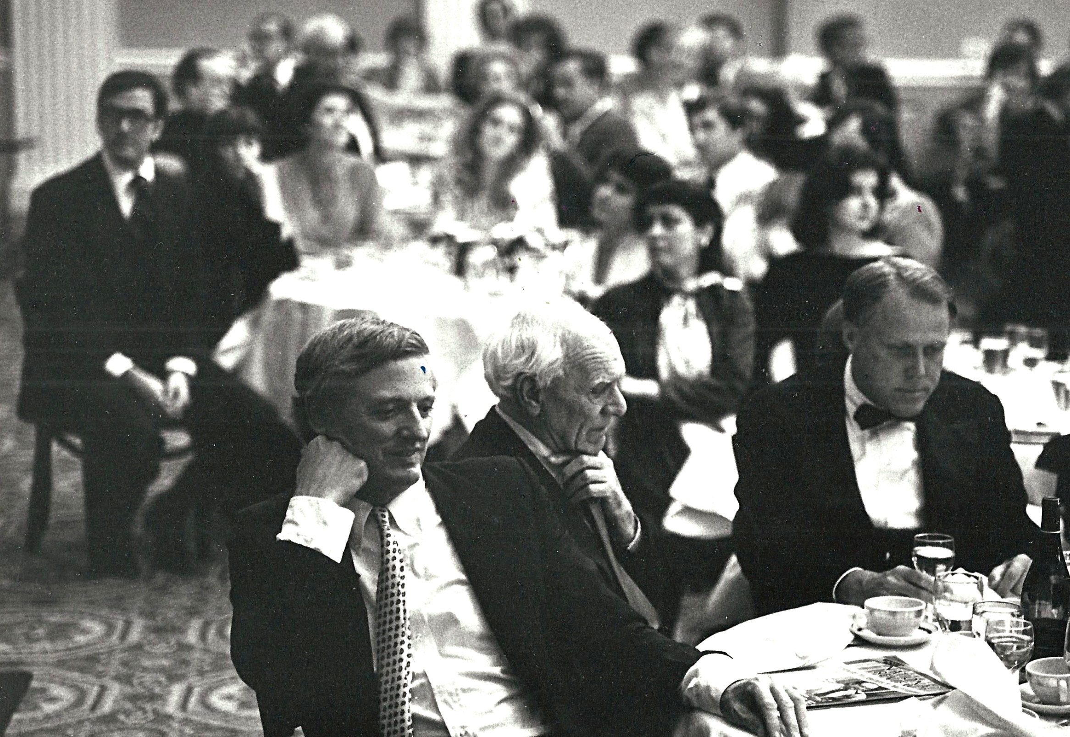
1974
2024
William F. Buckley, Jr. , Malcolm Muggeridge, and John T. Noonan

Slide 11
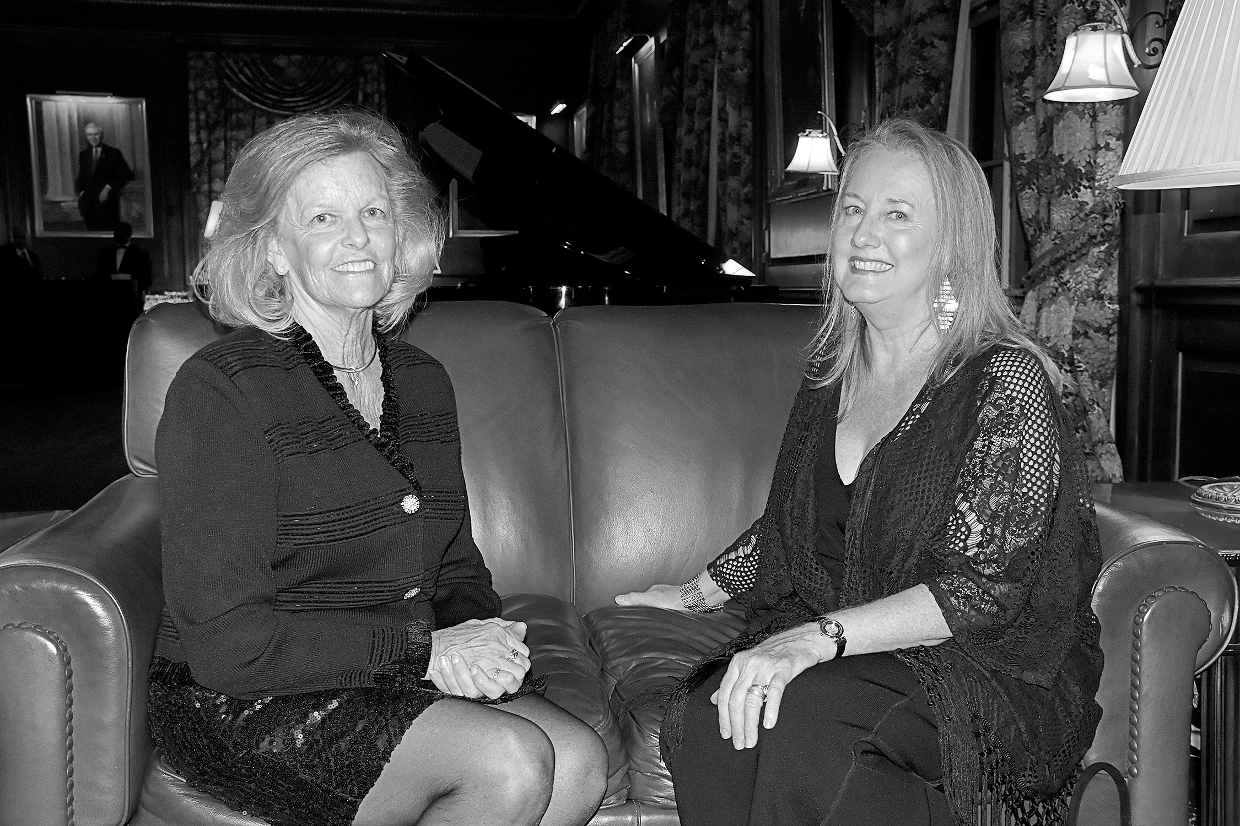
1974
2024
Anne Hendershott and Anne Conlon

Slide 12
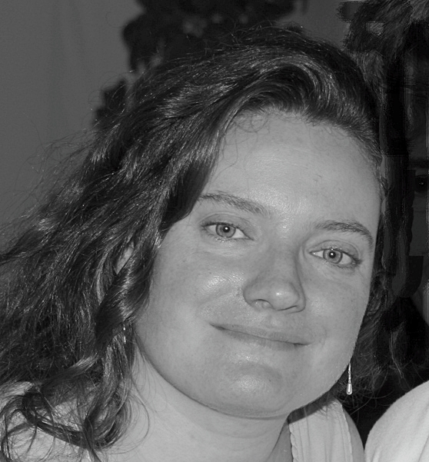
1974
2024
Christina Angelopolous, Managing Editor of the Human Life Review

Slide 13
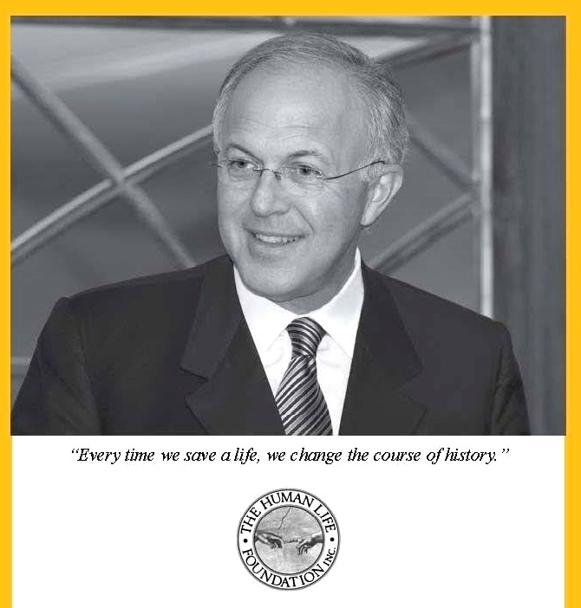
1974
2024
Carl Anderson, Great Defender of Life 2016

Slide 14
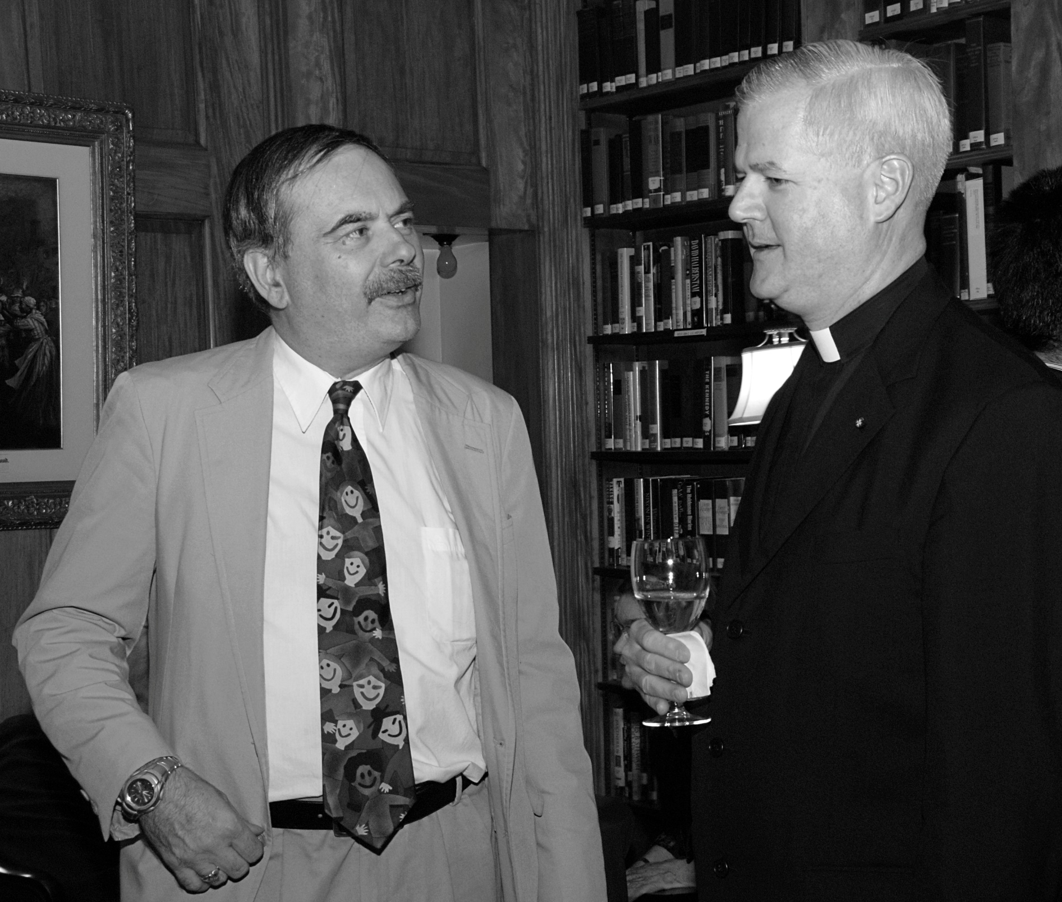
1974
2024
Chris Slattery and Fr. Gerald Murray

Slide 15
Congratulations to the Human Life Review on its fifty years of advancing the cause of human life in the womb by helping us understand how precious such a life is. I am proud to have been part of that effort for the past twenty-nine years, and deeply grateful for the encouragement of Editor-in-Chief Maria McFadden Maffucci and the expert guidance of Editor Anne Conlon.
—George McKenna, Great Defender of Life 2023

Slide 16
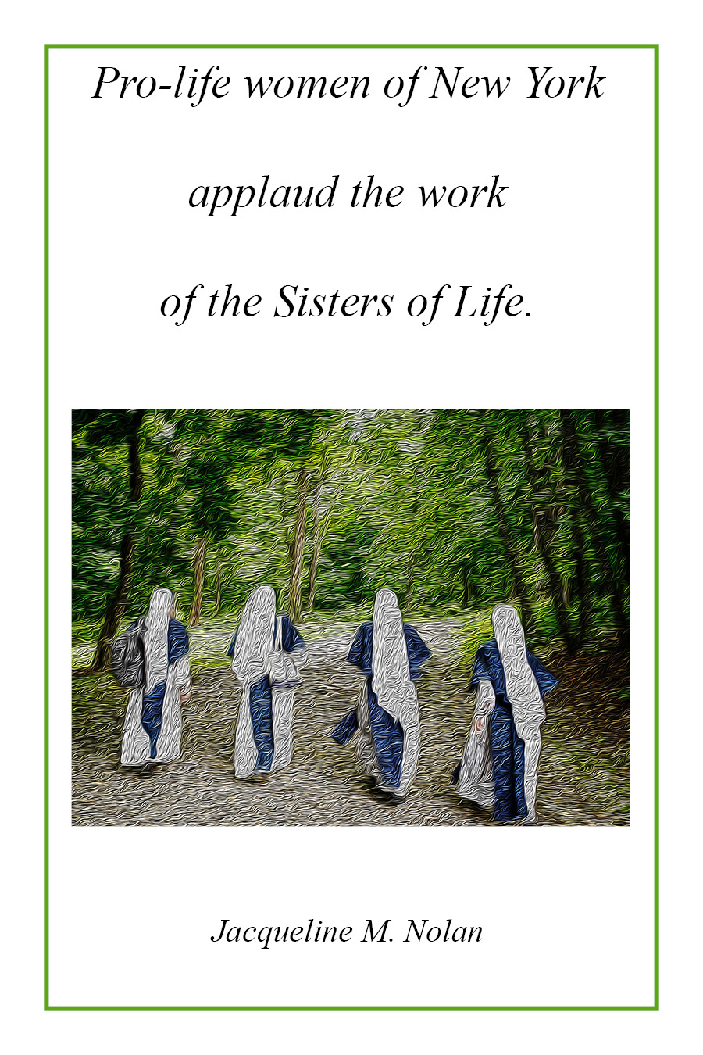

Slide 17
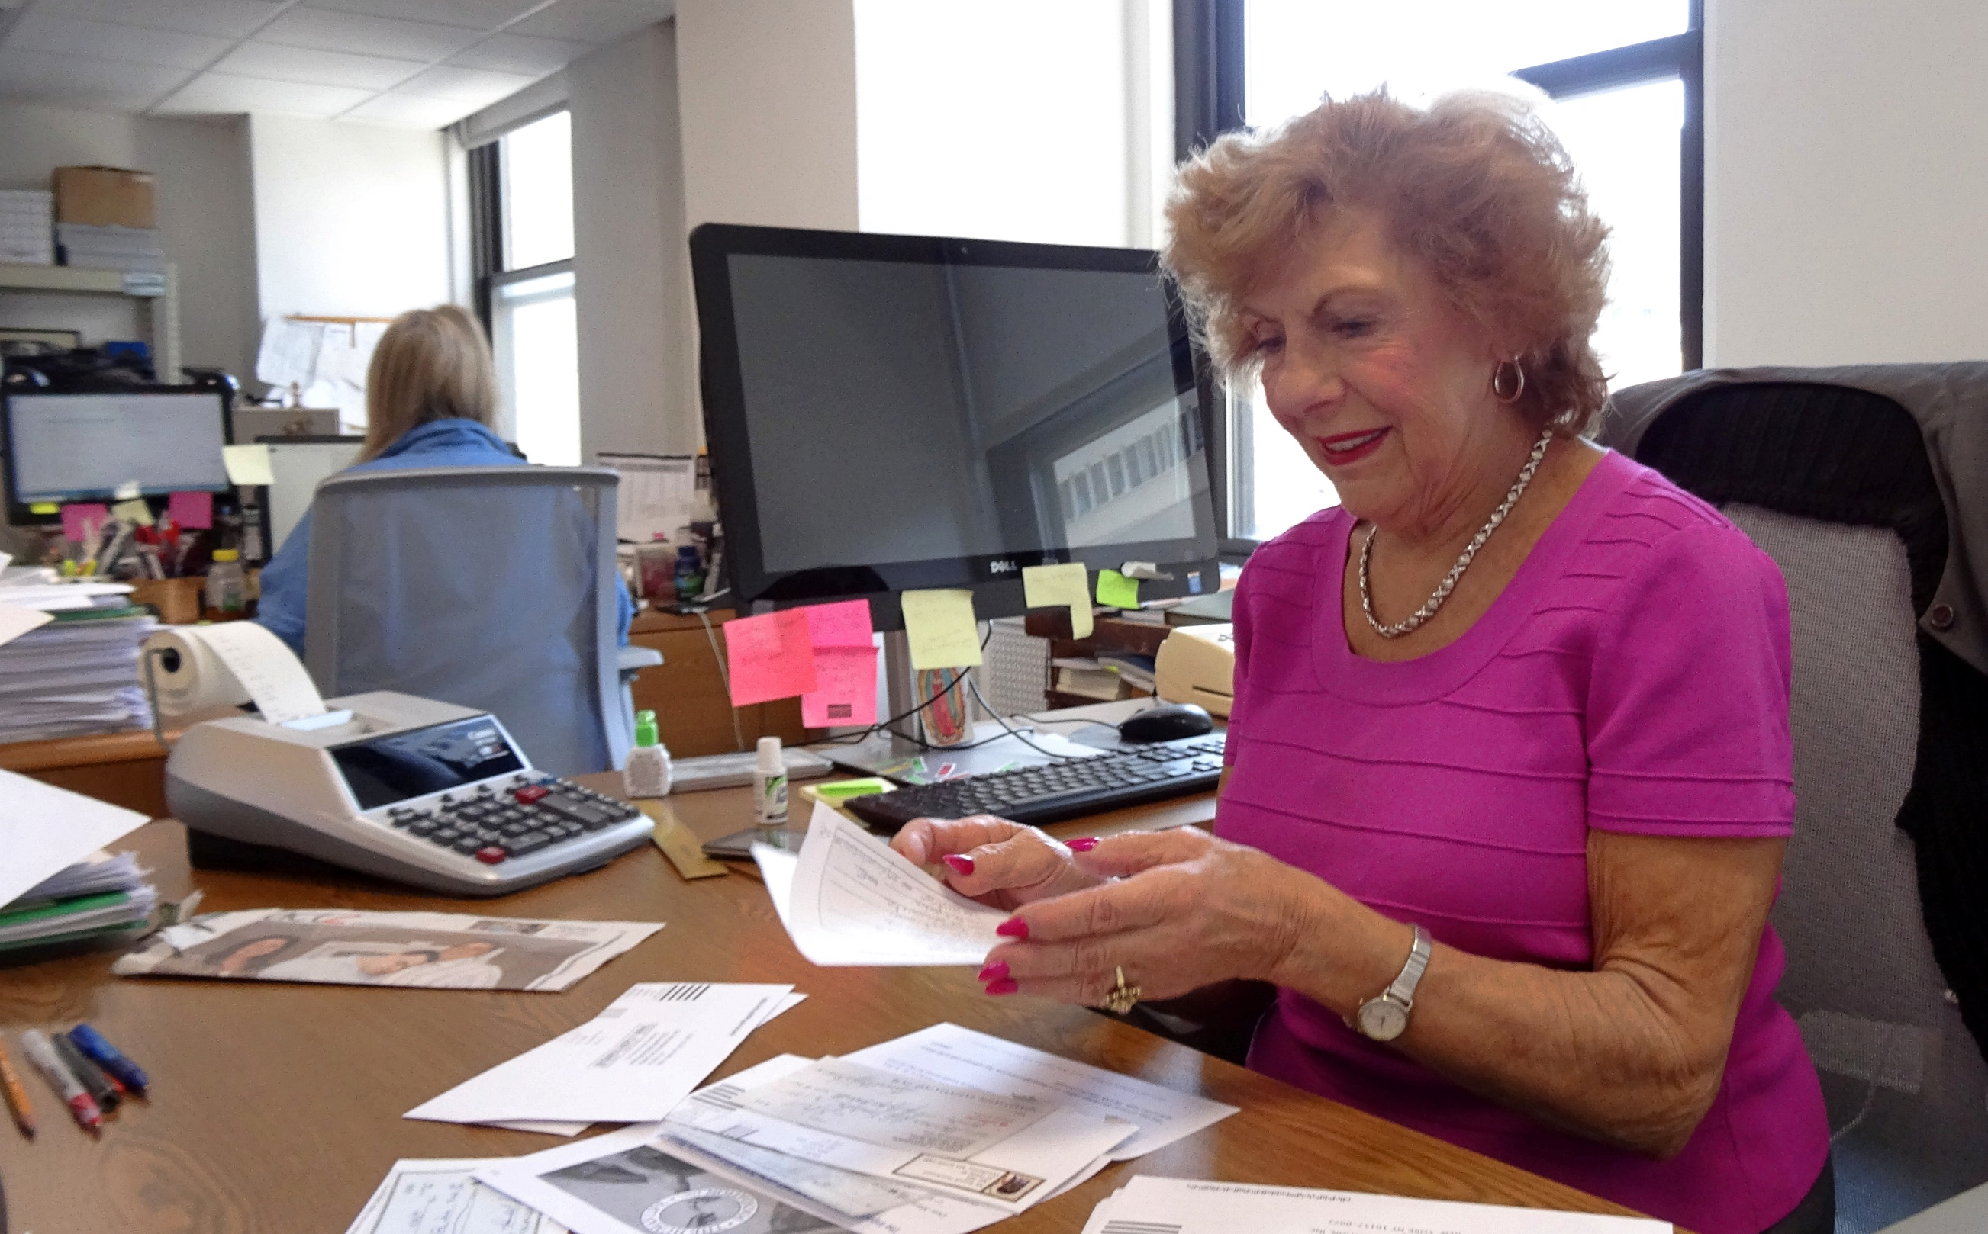
1974
2024
Rose Flynn DeMaio, Financial Manager

Slide 18
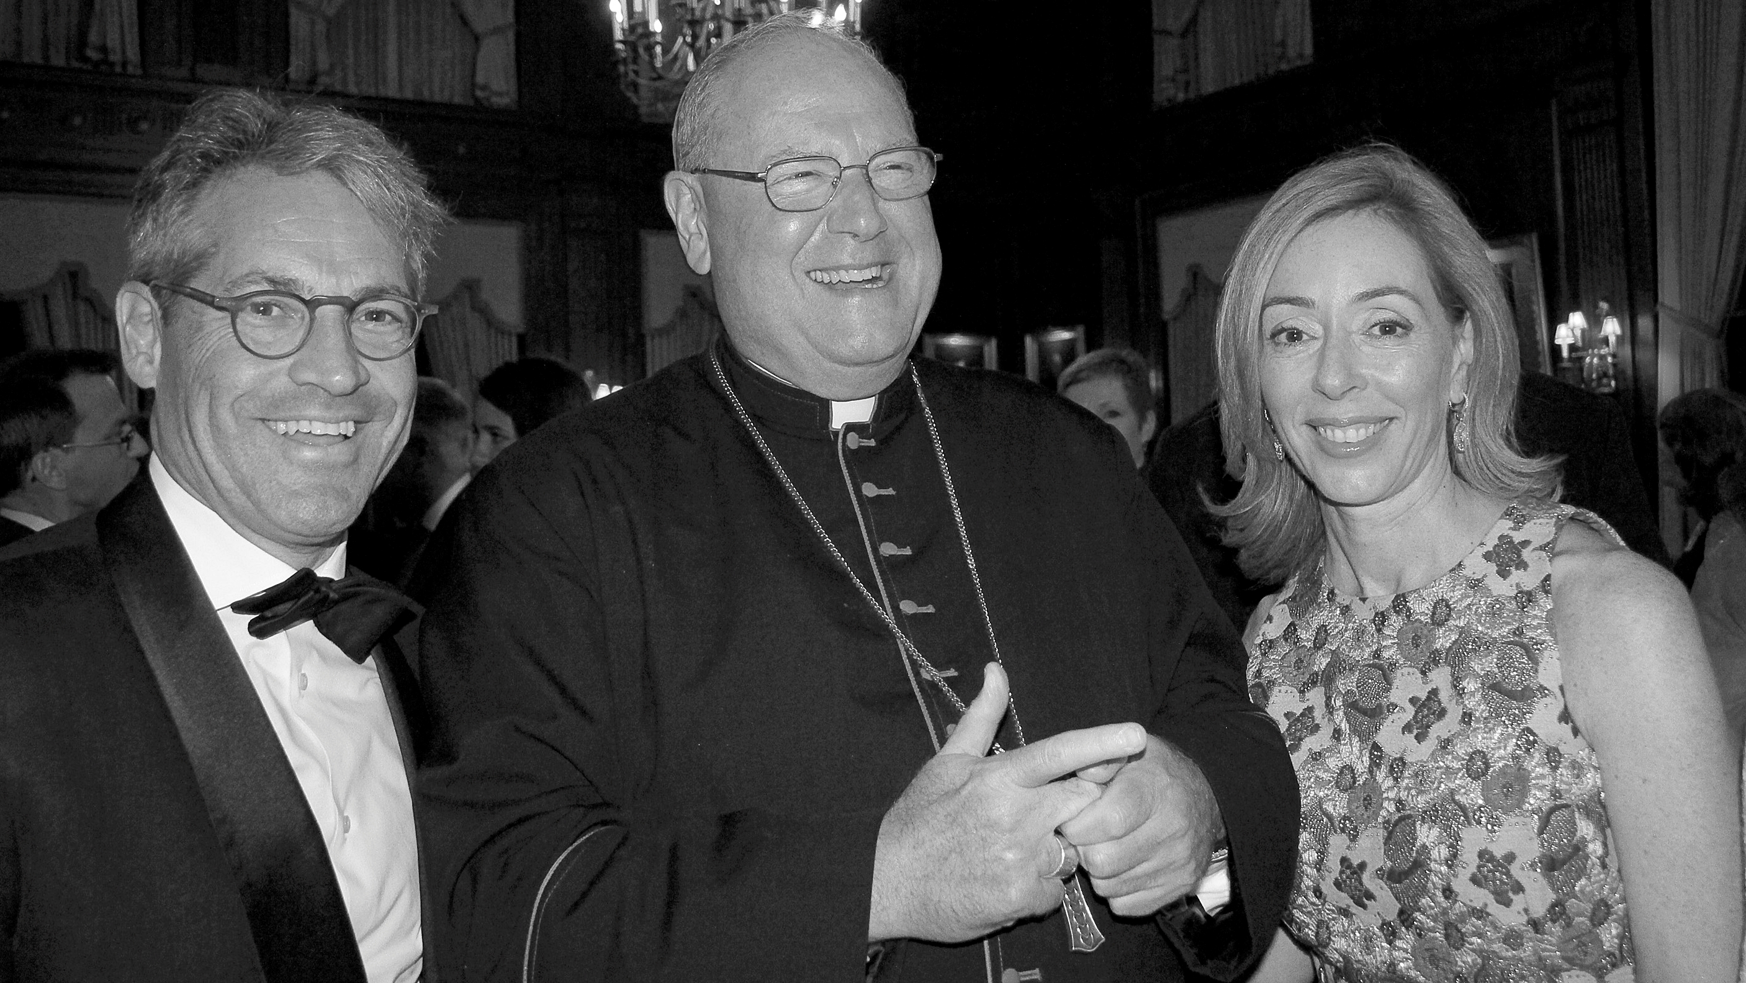
1974
2024
Cardinal Dolan with Eric and Susanne Metaxas

Slide 19
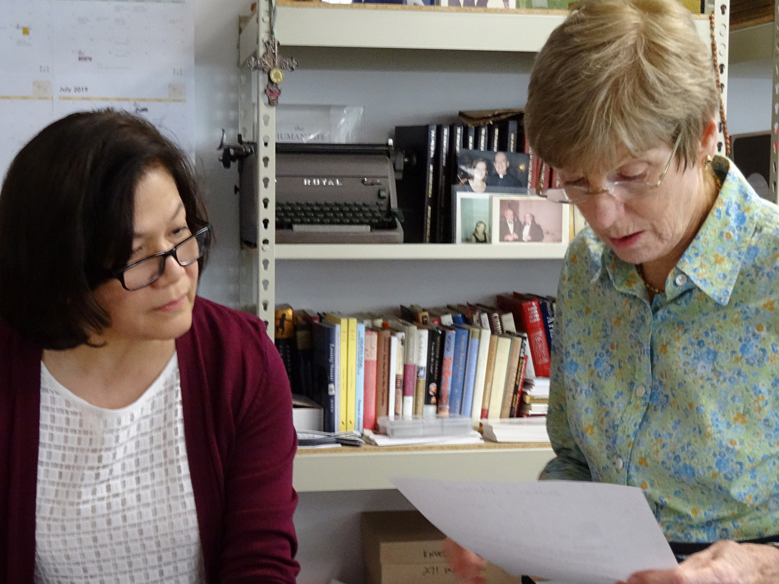
1974
2024
Ida Paz and Pat O’Brien

Slide 20
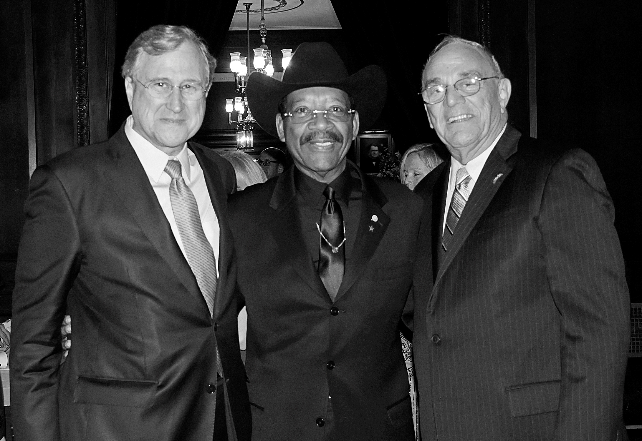
1974
2024
Ed Cox, Senator Ruben Diaz, and Mike Long

Slide 21
Congratulations to Human Life Review, Maria, Anne, and the Board and Staff, for 50 years of publishing compelling defenses of the inviolability of human life and of human dignity. Every mile has no doubt been difficult. But the variety of the genre, the creativity of the authors, the scope of the themes, have provided a richness of thought and a library of classical accounts. Not the least of which is Ronald Reagan’s 1984 essay, Abortion and the Conscience of the Nation. HLR have also stood out by publishing an array of accounts of the negative impact of abortion on women. I’m proud to have nearly a full set of issues, and I have returned to that library repeatedly for research for my own writing and for inspiration. Best wishes for many more decades as we work to build an enduring majority for life.
1974
2024
—Clarke Forsythe, Senior Counsel, Americans United for Life

Slide 22
Narrow Straits
Piloting Services
In the port of
Portland Maine

Slide 23
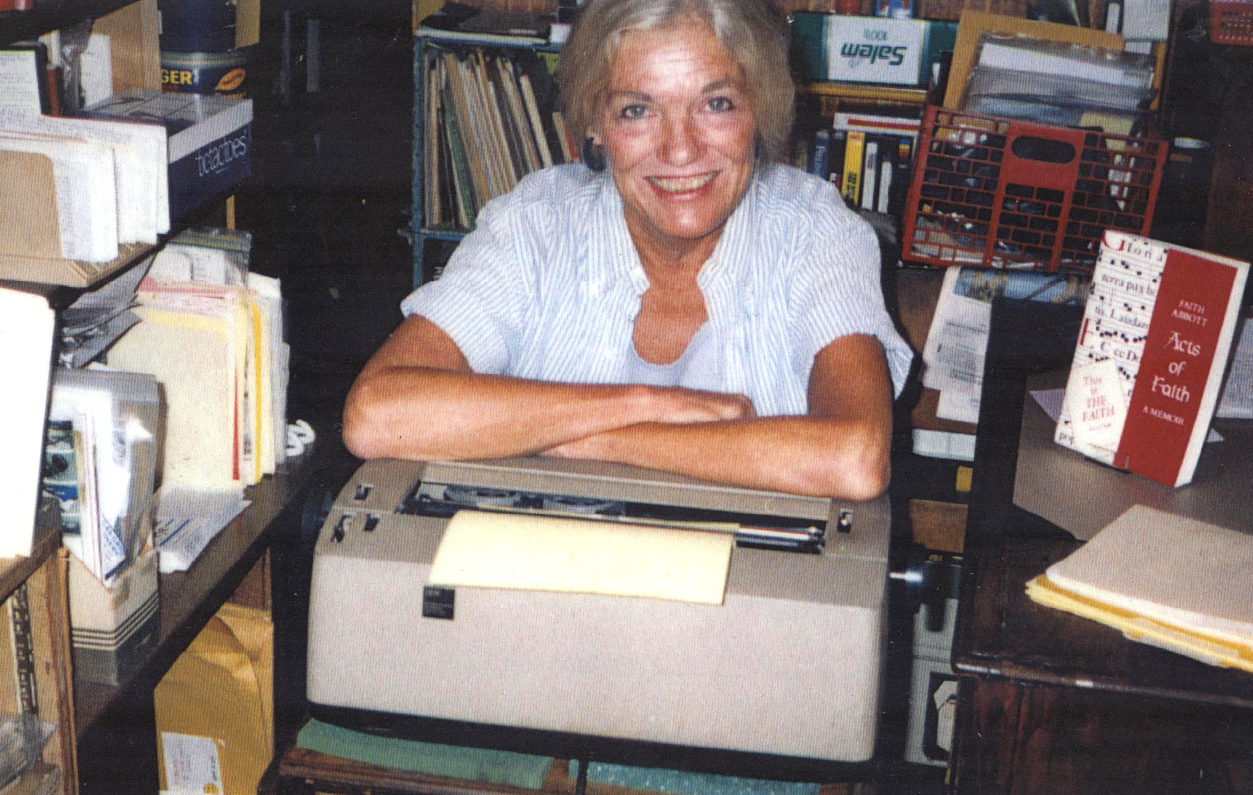
1974
2024
Faith Abott McFadden

Slide 24
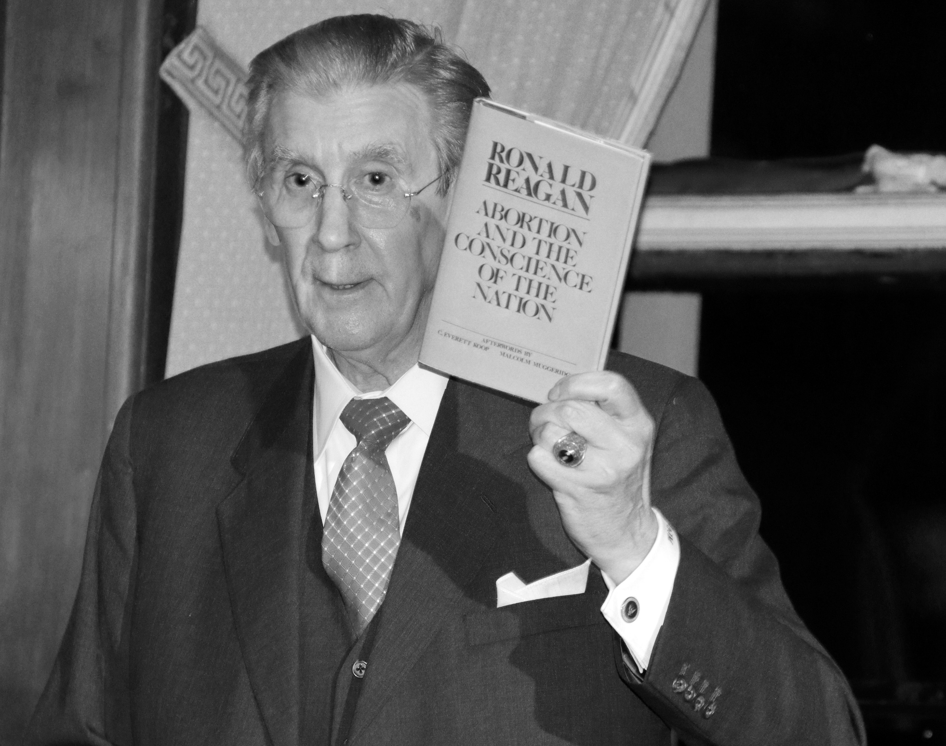
1974
2024
George Marlin

Slide 25
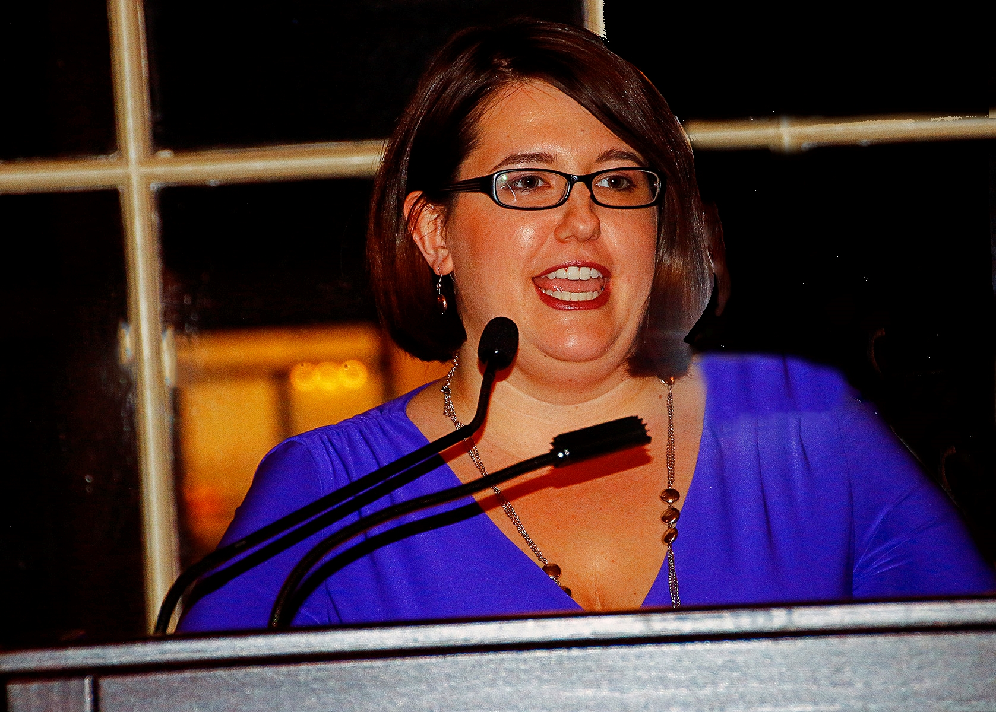
1974
2024
Kristan Hawkins

Slide 26
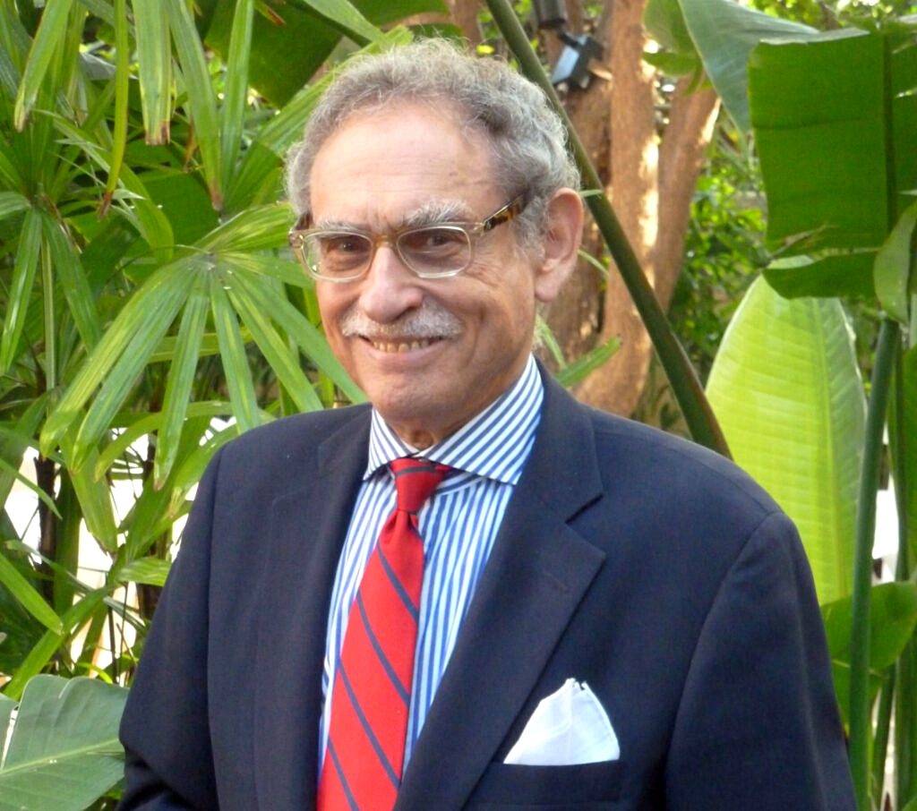
1974
2024
Hadley Arkes

Slide 27
The Veritas Center for Ethics in Public Life at Franciscan University
Franciscan.edu/Veritas

Slide 28
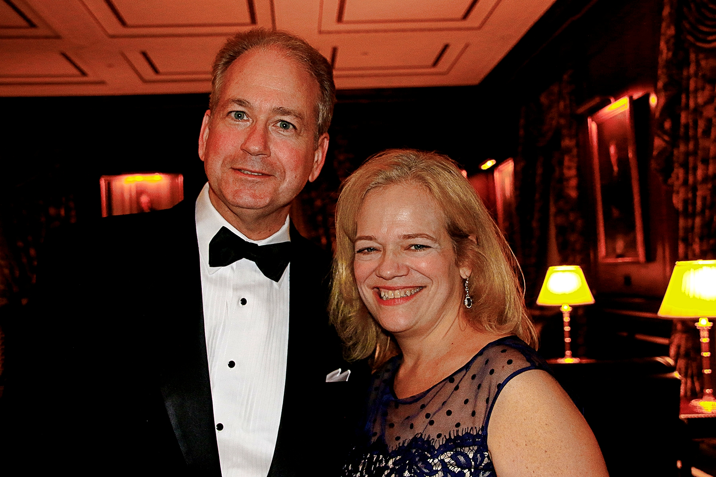
1974
2024
Clarke Forsythe with Maria Maffucci

Slide 29
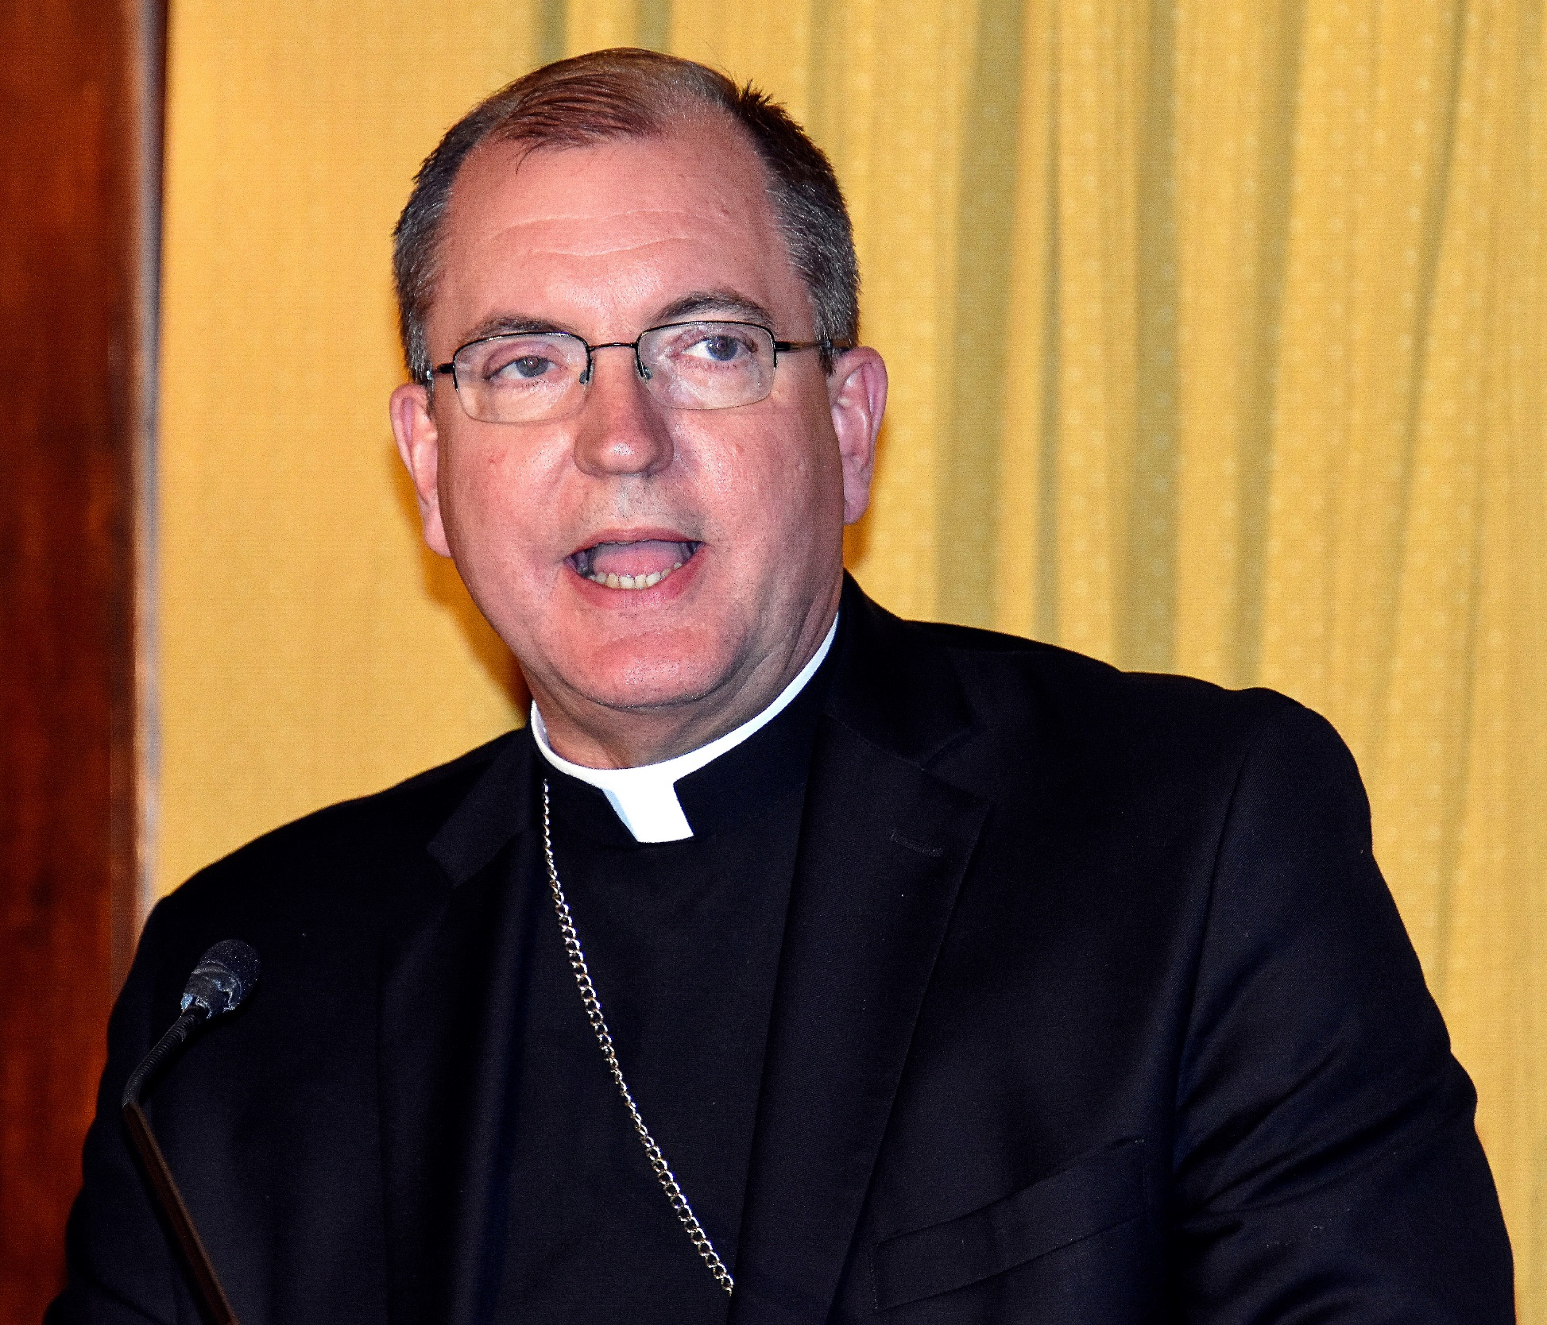
1974
2024
Bishop John Barres

Slide 30
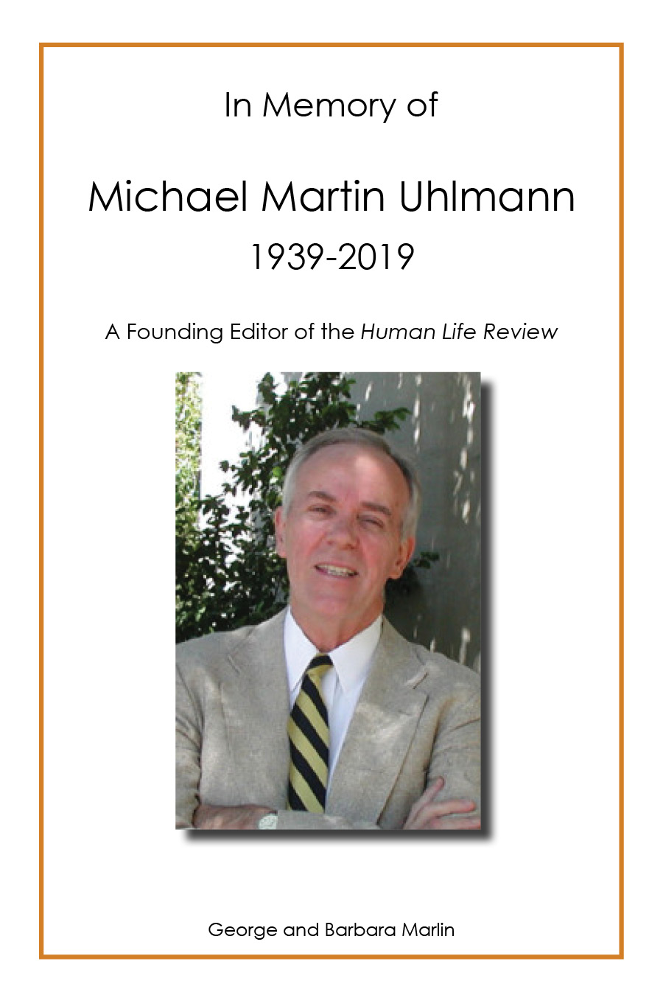
George and
Barbara Marlin
Remember
Michael Martin Uhlmann

Slide 31
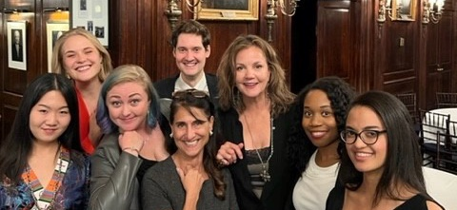
Feminists Choosing Life of New York

Slide 33
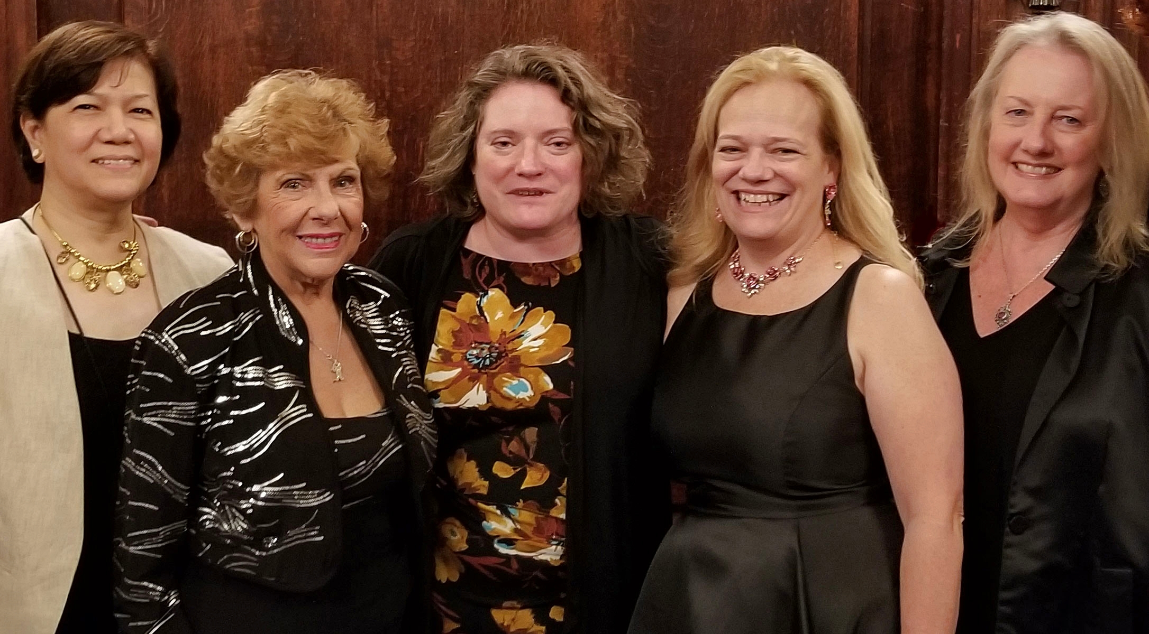
1974
2024
“The Merry Band of Troublemakers”

Slide 34
1974
2024
Mother Teresa and Henry Hyde read The Human Life Review

Slide 35
Knights of Columbus Asset Advisors
KofCAssetAdvisors.org

Slide 36
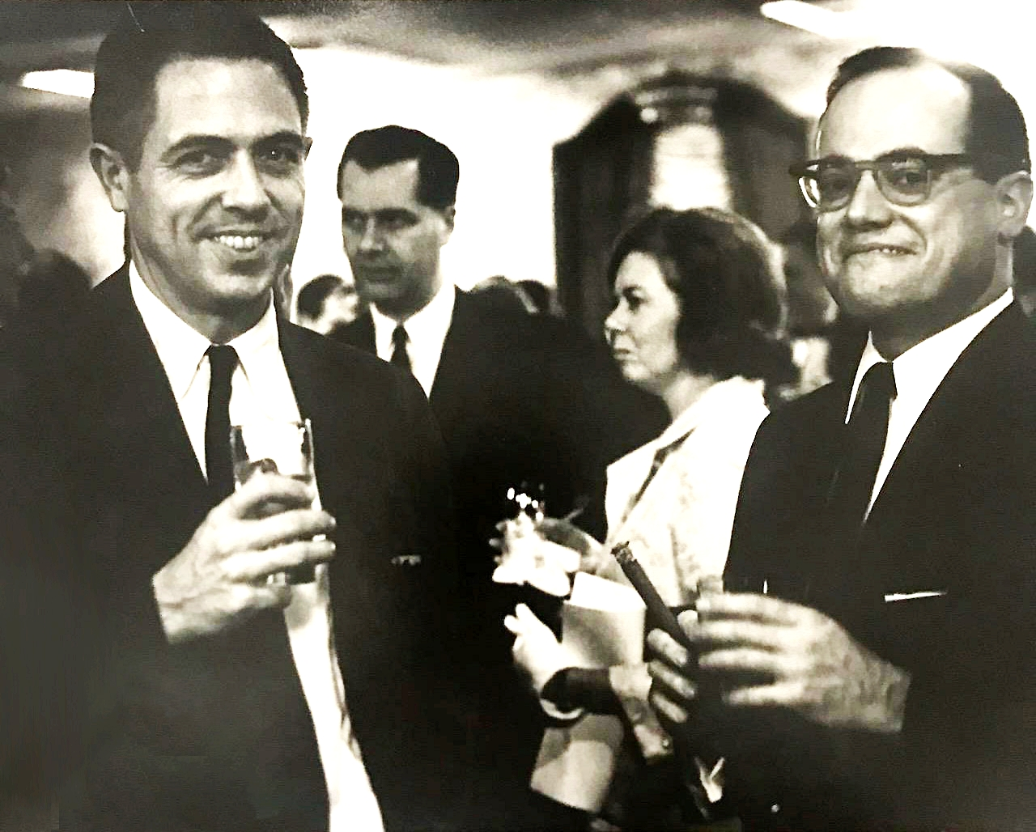
1974
2024
James Buckley and J. P. McFadden

Slide 37
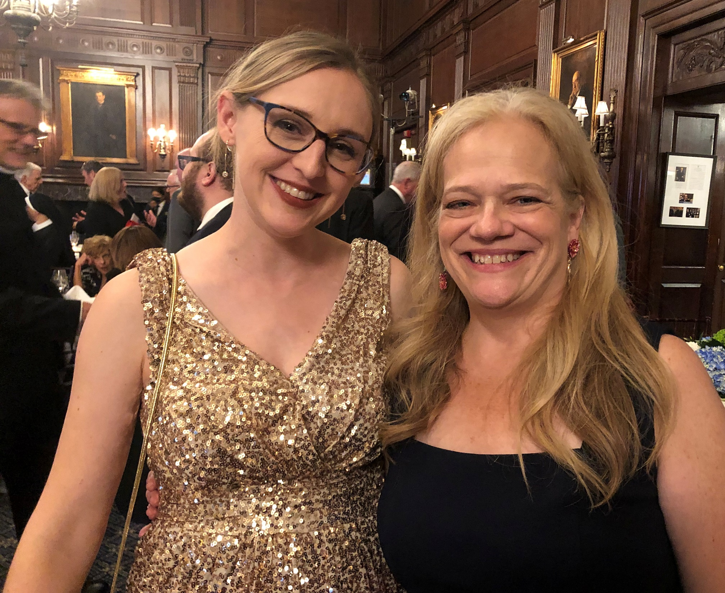
1974
2024
Mary Rose Somarriba and Maria McFadden Maffucci

Slide 38
ANLON
FINANCIAL
STRATEGIES
Keith F. Ryan
631-923-7576
Keith@anlonfs.com

Slide 39
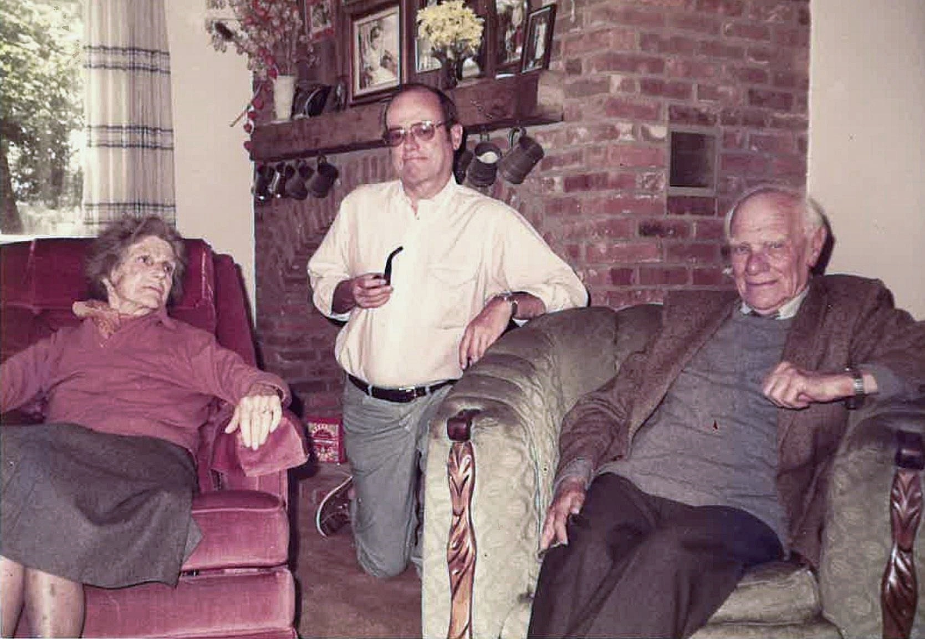
1974
2024
Kitty and Malcolm Muggeridge with J. P. McFadden

Slide 40
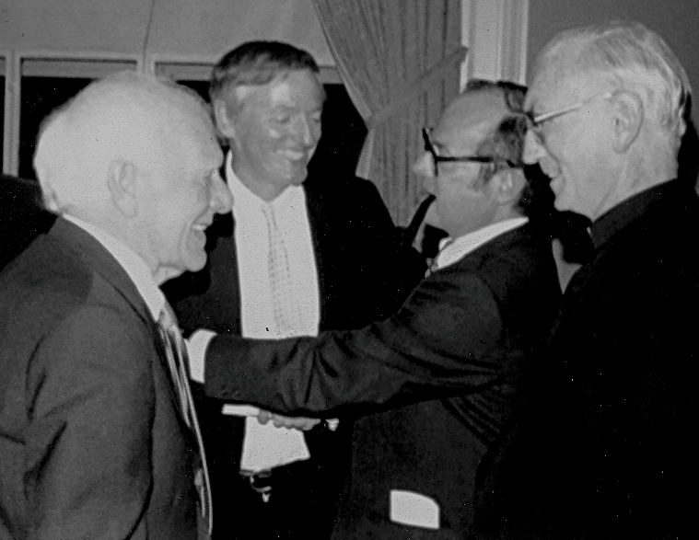
1974
2024
Malcolm Muggeridge, William F. Buckley Jr., J.P. McFadden, and Fr. Francis Canavan

Slide 41
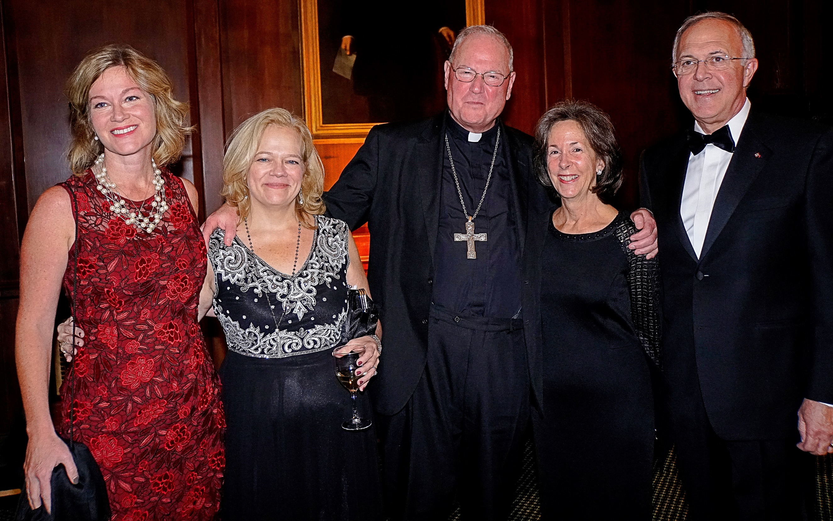
1974
2024
Jean Mancini, Maria McFadden Maffucci, Archbishop Cardinal Dolan, and Dorian and Carl Anderson

Slide 42
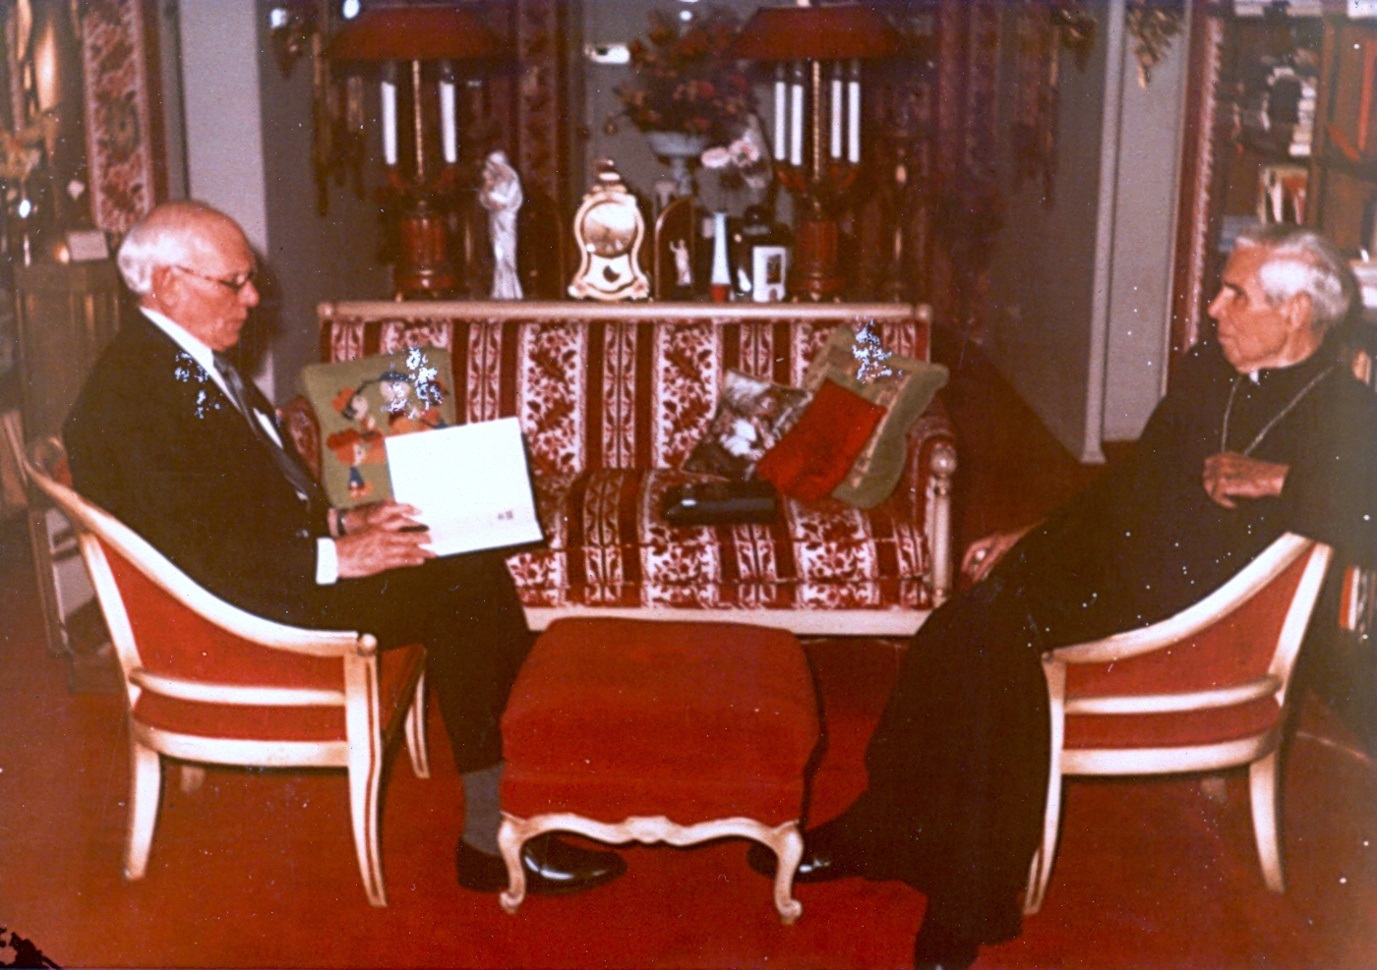
1974
2024
Malcolm Muggeridge and Archbishop Sheen

Slide 43
David Quinn, Great Defender of Life 2018:
“When the Roe vs Wade ruling was issued in 1973, it was vital at such a low point that someone should step up to provide intellectual leadership for the pro-life movement. Jim McFadden and Human Life Review did exactly that. Jim and HLR helped to keep the pro-life flag aloft. HLR, and Jim’s successors at HLR, has been doing so for 50 years now publishing some of the most important articles by the most important figures from the pro-life movement. These have shown the way ahead philosophically, tactically and politically. Those of us who are part of the pro-life cause in Ireland have always been aware of HLR and the leadership it has provided. Both in Ireland and the US, the big challenge before us is to change not just the law, but the culture, and to make it more supportive of the right-to-life and to persuade people that a society in which abortion is so commonplace serves no-one, including women. I am confident Human Life Review will continue to provide leadership in the years and decades to come. It is needed now as much as ever.”

Slide 44
Allen and Mary Roth
Choose as their hero
John Hinshaw

Slide 45
1974
2024
Maria McFadden Maffucci and Fr. Neuhaus

Slide 46
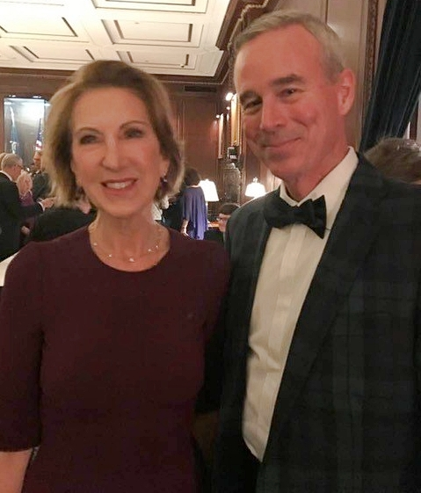
1974
2024
Carly Fiorina, Great Defender of Life 2017, with Michael Hayes Jr.

Slide 47
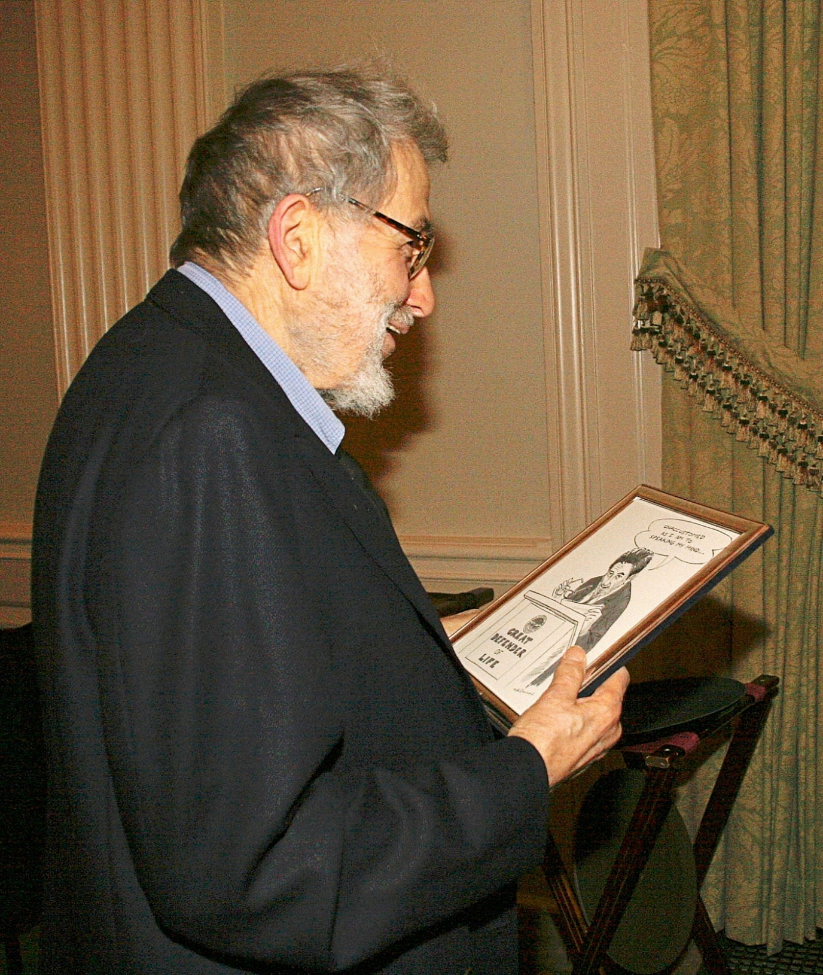
1974
2024
Nat Hentoff, Great Defender of Life 2005

Slide 48
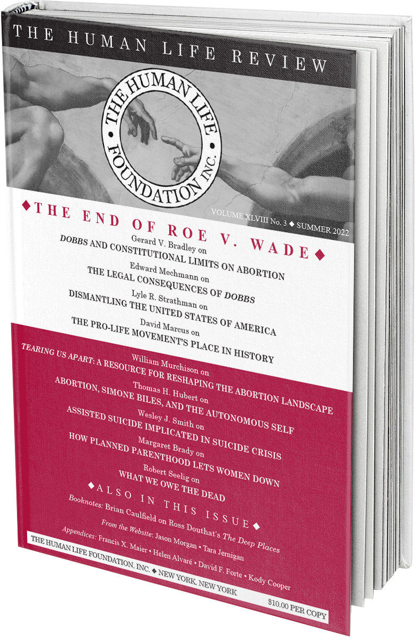
Nearly 40 years ago an issue of HLR that included an article by me sat on my office desk at The University of Texas. A professor saw it, read some of the article titles on the cover, and said with a sneer, “That’s a narrow topic for a journal.” Congratulations to HLR on its golden narrowness, and to its earnest editors for caring more about truth than popularity.
—Marvin Olasky, Great Defender of Life 2021

Slide 49
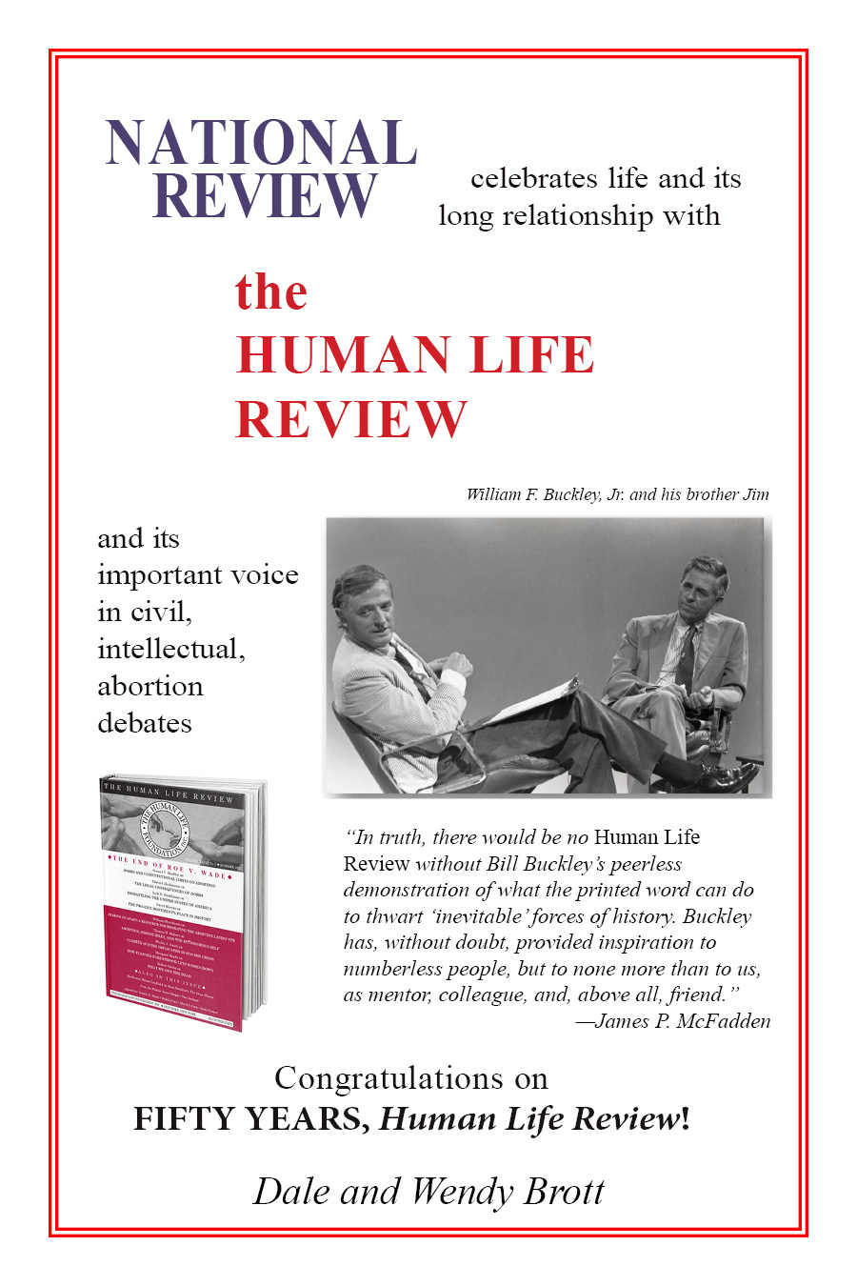
Congratulations on
FIFTY YEARS,
Human Life Review!
Dale and Wendy
Brott

Slide 50
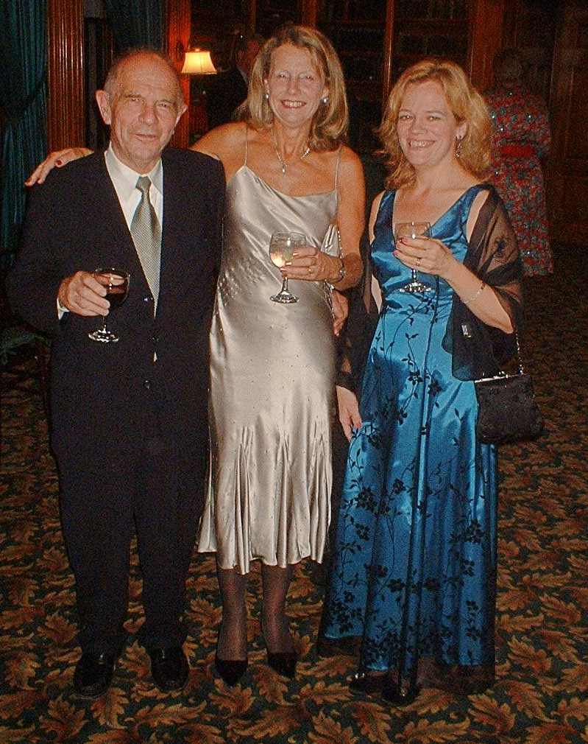
1974
2024
John and Sally Muggeridge with Maria McFadden Maffucci

Slide 51
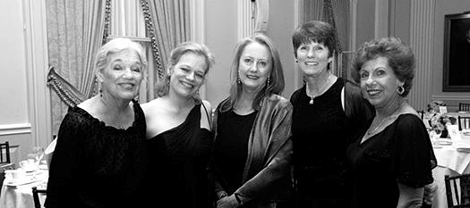
1974
2024
Faith, Maria, Anne, Pat, and Rose

Slide 52
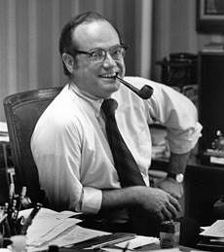
1974
2024
J.P. McFadden

Slide 53
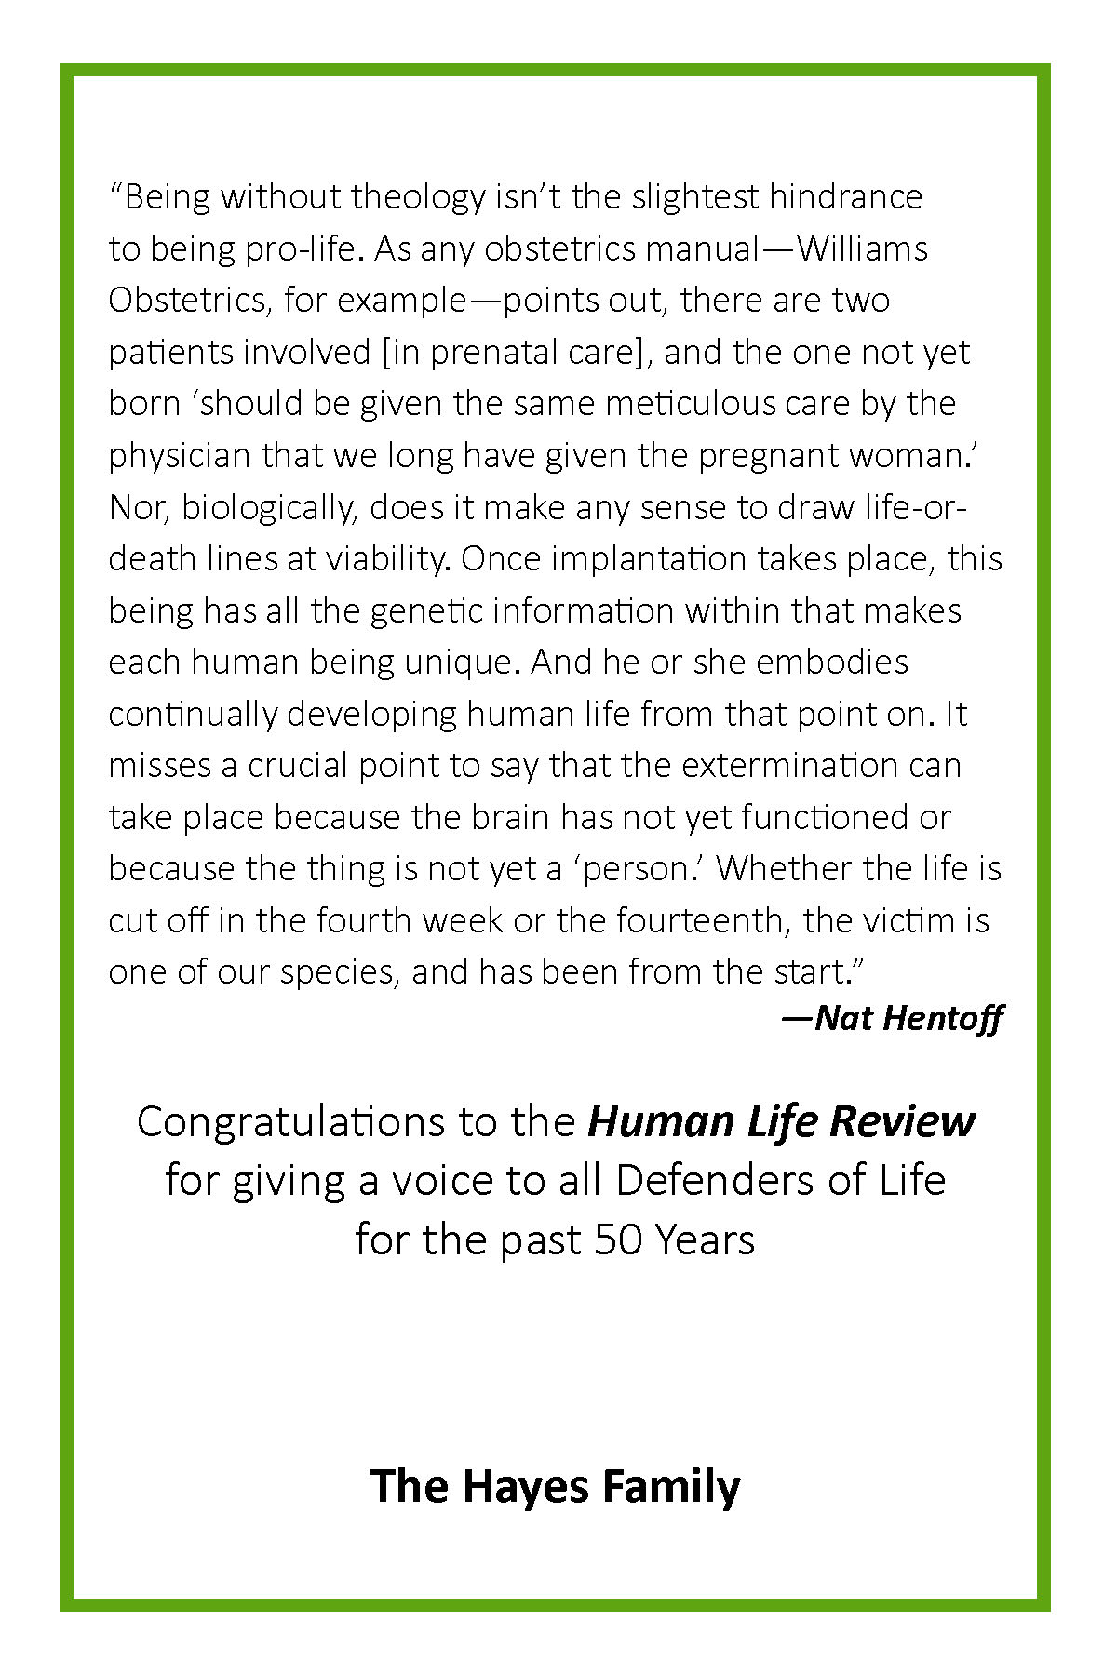
Remembering Nat Hentoff
The Hayes Family

Slide 54
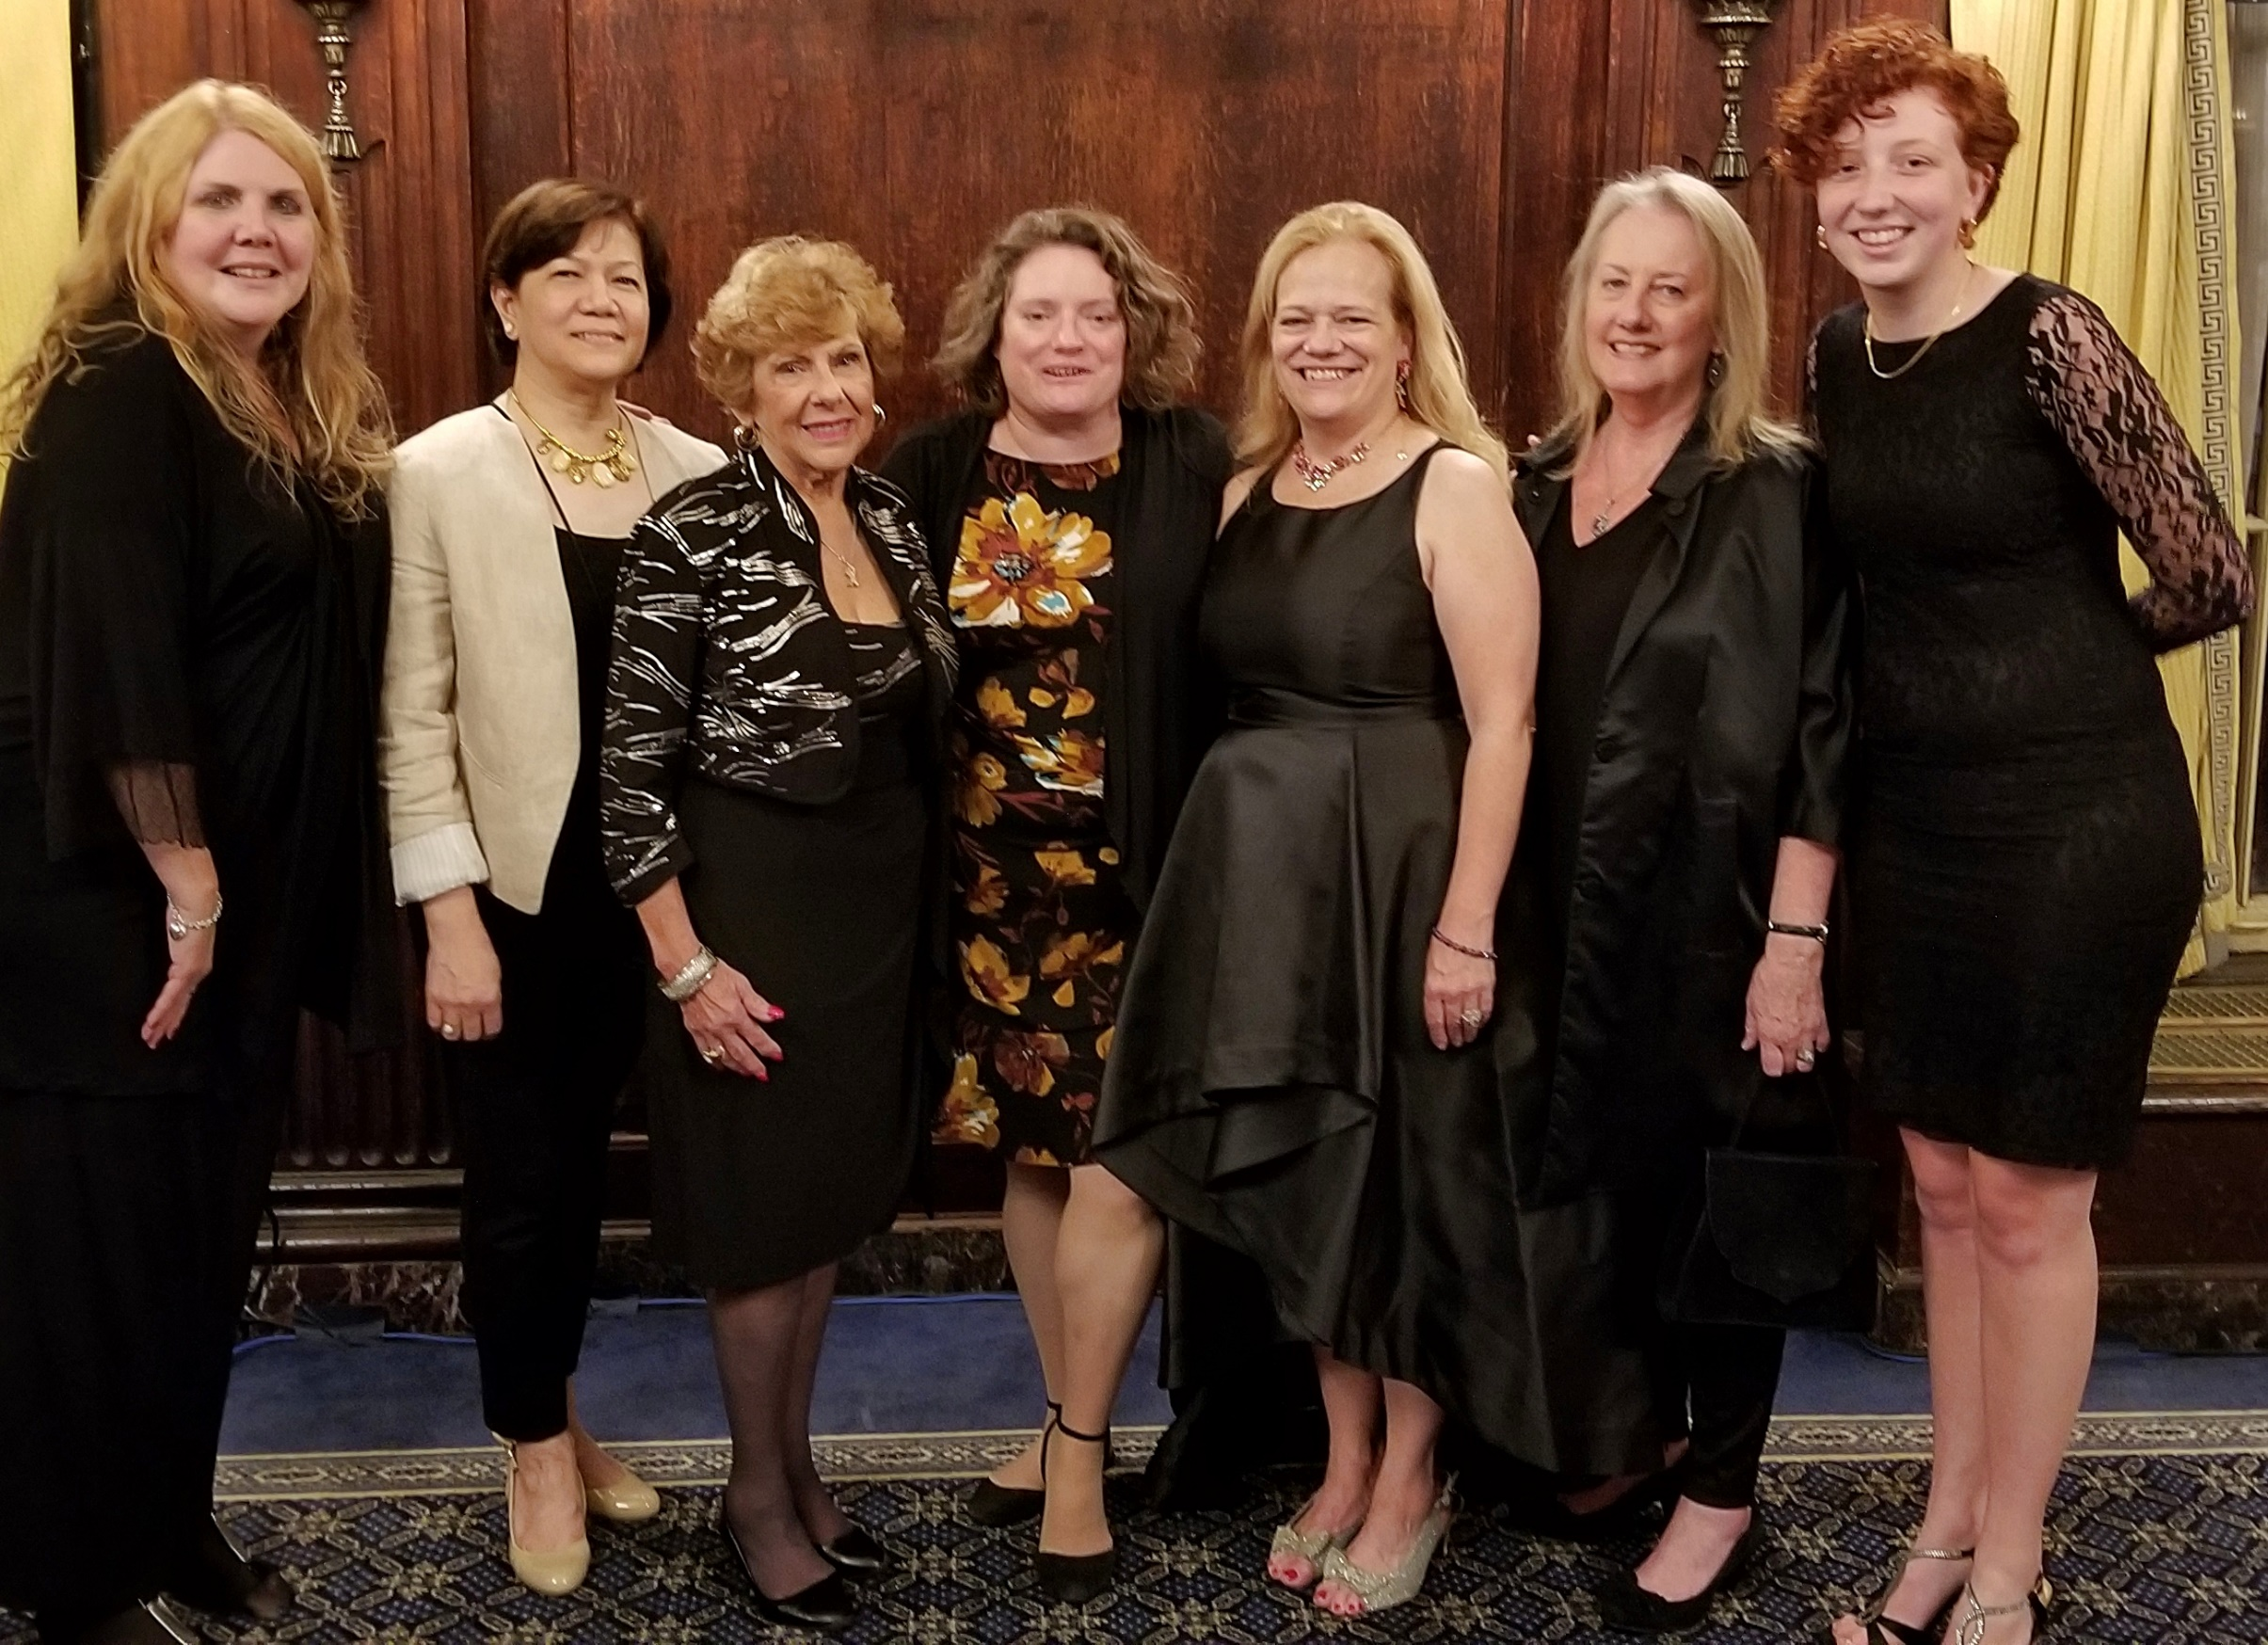
Jane Devanny, Ida Paz, Rose Flynn DeMaio, Christina Angelopoulos,
Maria Maffucci, Anne Colon, and Dominique Cognetti

Slide 55
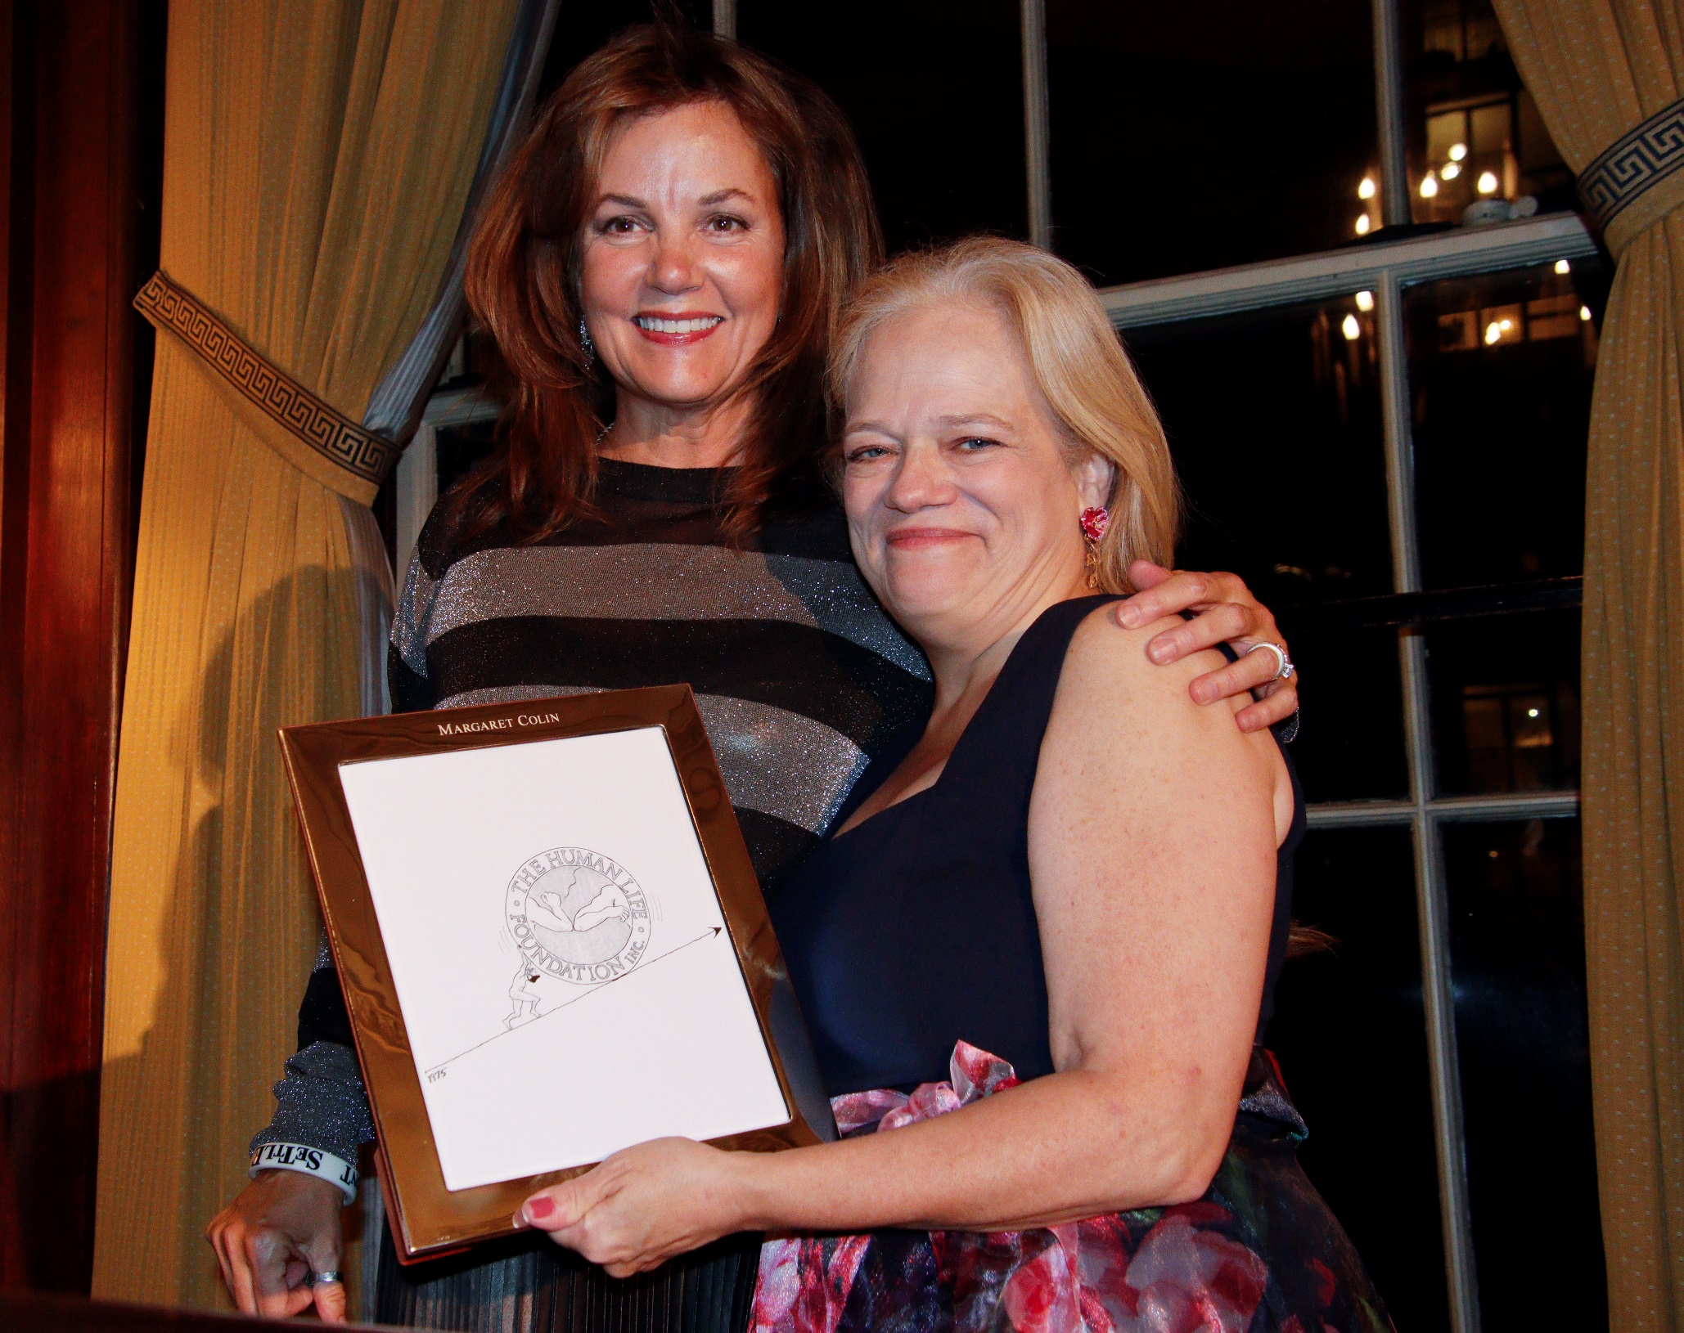
1974
2024
Margaret Colin, Great Defender of Life 2021, and Maria McFadden Maffucci

Slide 56
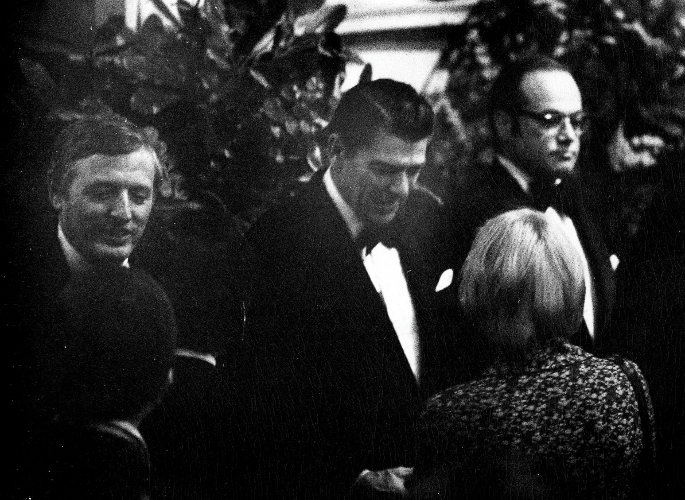
1974
2024
William F. Buckley Jr., Ronald Reagan, and J. P. McFadden

Slide 57
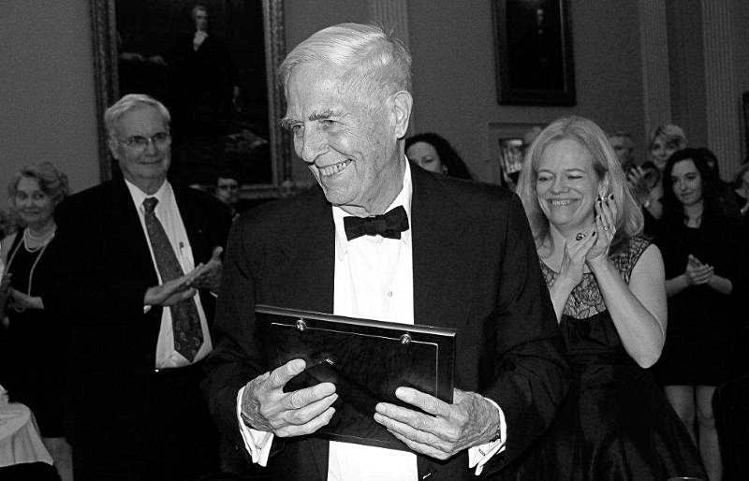
1974
2024
Senator James Buckley, Great Defender of Life 2012

Slide 58
William McGurn, Great Defender of Life 2010:
“The Human Life Review has been the most important journal in the pro-life movement from Day One. Now it is Year Fifty, and the Review is still the standard-bearer, the go-to resource for all of us in the fight for unborn life. Dobbs is a game-changer. But the challenges ahead -- though different -- are no less daunting. Our tiniest brothers and sisters need the Review’s insights, courage, and witness to the truth more than ever. My sincerest congratulations, and thanks, to Maria McFadden and her collaborators for keeping this beacon so well-lit.”

Slide 59
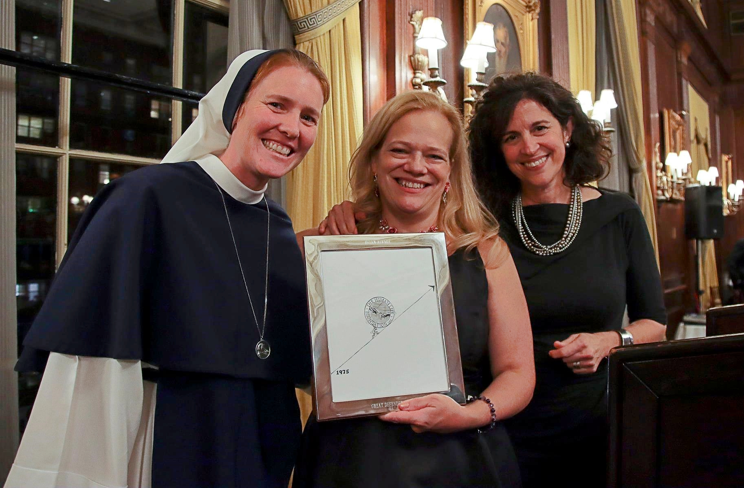
1974
2024
Sr. Bethany, Maria McFadden Maffucci, and Helen Alvaré, Great Defender of Life 2019

Slide 60
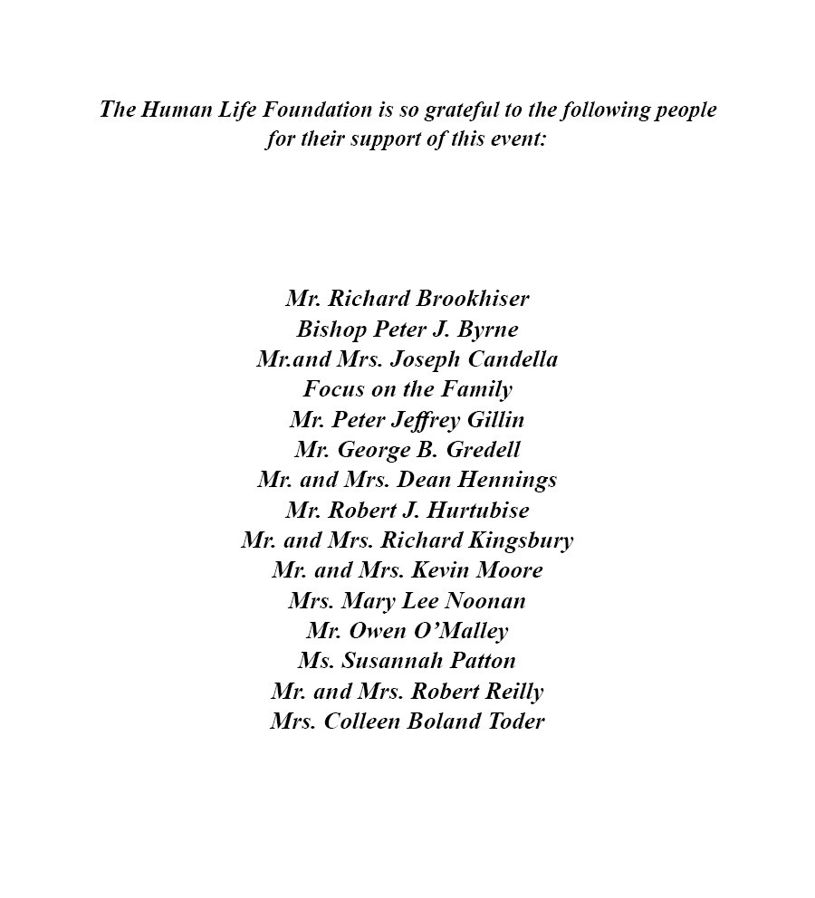

Slide 61
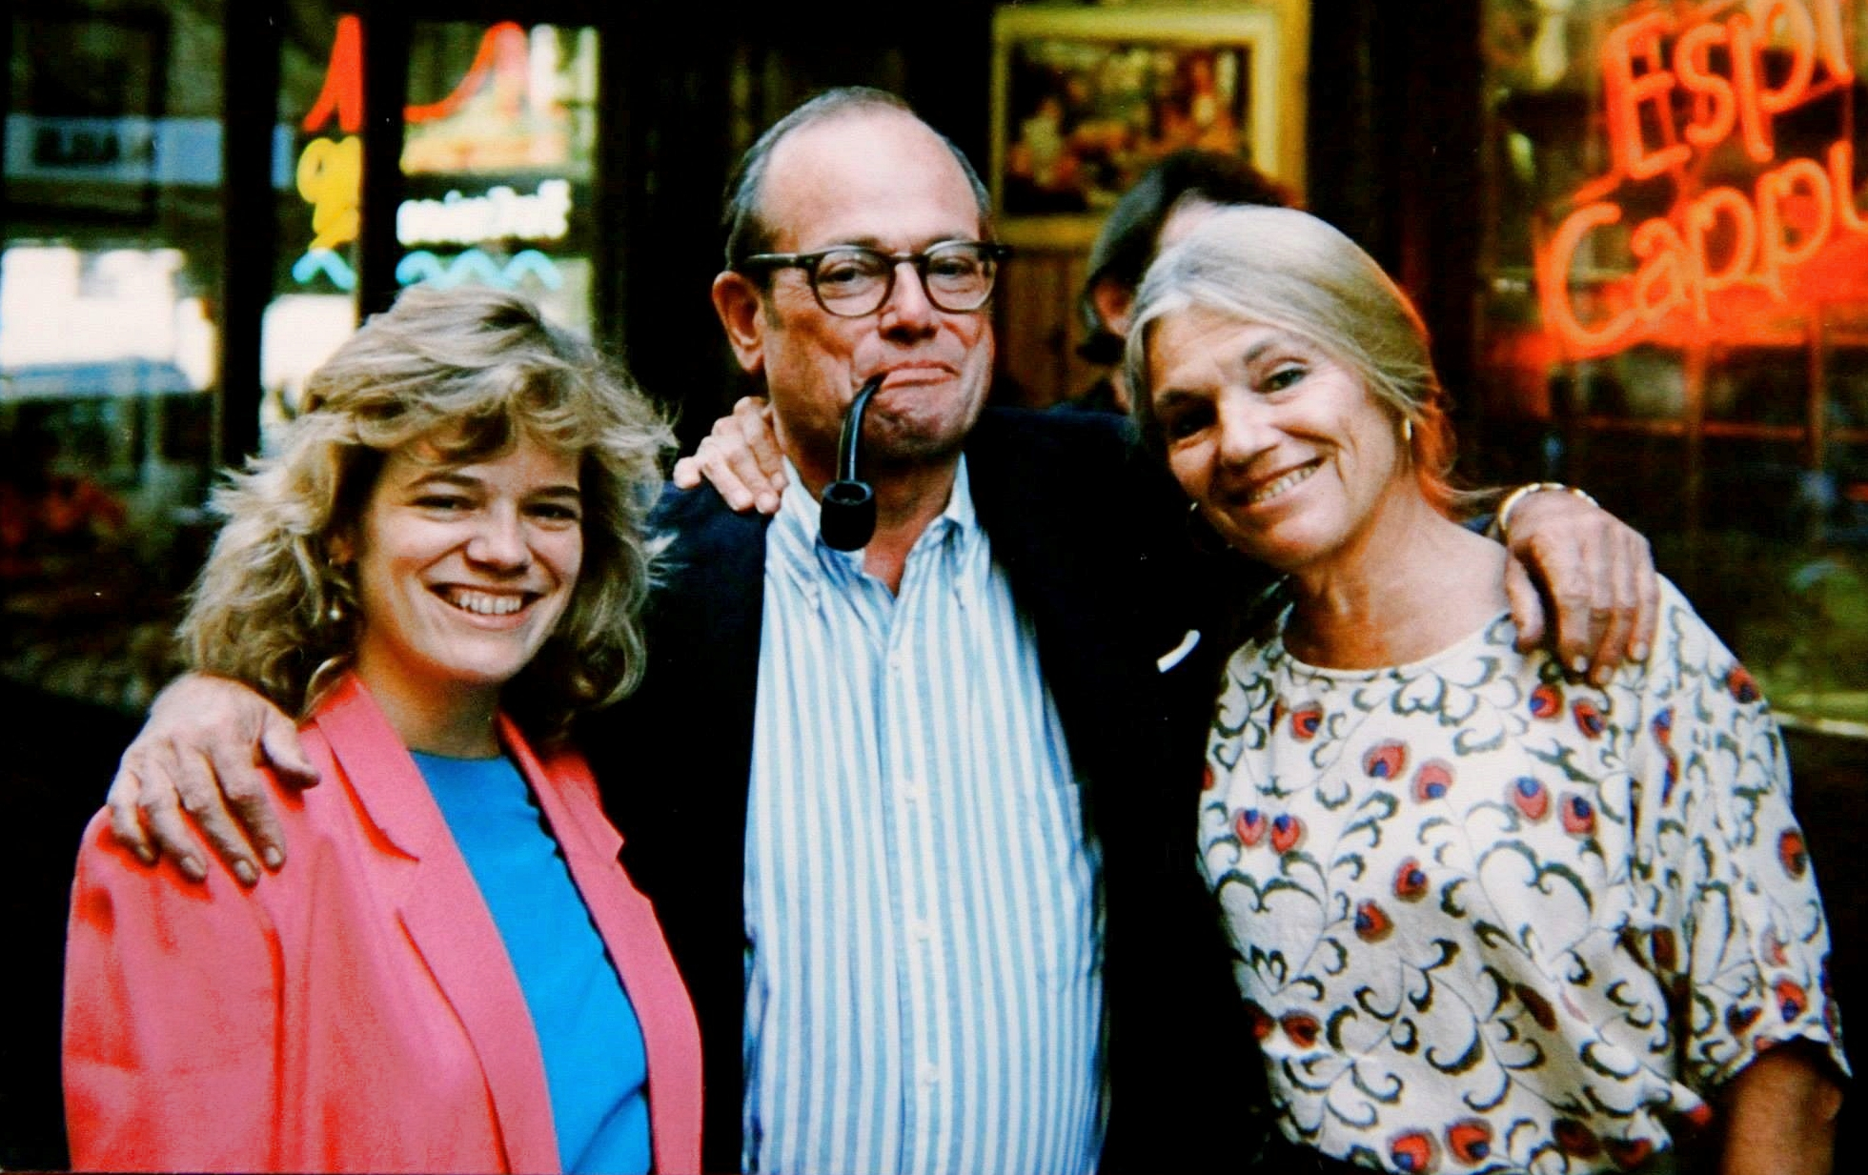
1974
2024
Maria McFadden Maffucci, J. P. McFadden, and Faith McFadden

Slide 62
Feminists Choosing
Life
of New York
FCLNY.ORG
585-730-7808
Rochester, NY
Chosen Heroes of the Charles and Mary Crossed Foundation

Slide 63
^{A special thanks to}
^{Brent Buterbaugh}
^{Castletown Media}
^{Dominique Cognetti}
^{Jane Devanny}
^{David DiCerto}
^{Eileen Fitzsimons}
^{Michael Fusco}
^{Taylor Hoyt}
^{Jeffrey Lederfarb}
^{Joseph Longo}
^{Kerri Phillips}
^{Chris Reilly}
^{Elliot Small}

Slide 64
